Slide 1
Dan Flashes
A SPEC KIT FIELD REPORT
Complicated shirts. Complicated prices.
How I built a parody e-commerce store spec-first with GitHub Spec Kit and Claude Code, and what it cost.
Derek DenHartigh · Nishtech · November 12, 2026
Notes:
Dan Flashes is the shirt store from the “I Think You Should Leave” sketch by Tim Robinson – I’d play it, but while its set in a professional setting, its certainly not professional.
This was a learning project for GitHub Spec Kit after I learned about it at Barret Blake’s talk at Beer City Code 2026.
In this talk I’ll cover how Spec Kit works, how I drove it, how every decision ended up in git, and the pros and cons, and show off my goofy demo site.

Slide 2
The ask
DAY 1 · 2026-10-12
Learn Spec Kit
MY FIRST PROMPT
After Barret Blake’s talk at Beer City Code 2026.
“I want to build an ecommerce site branded for Dan Flashes that sells expensive shirts where the pattern complexity correlates to the price, the shirts are all to be vibrant, the store energy is to be aggressively upbeat and addictive.”
Build a parody
Dan Flashes, from “I Think You Should Leave”.
Make it real
A real stack and real tests. Fake money only.
DAN FLASHES × SPEC KIT
02
Notes:
This prompt was how it started, I even gave it bad advice on how to start using spec kit (because I was / am a noob) “we should probably clone the spec kit into the dan flashes root dir… then walk through the proper spec kit steps of defining the constitution and other required md files.”
Claude instantly corrected me and told me how to properly set up a spec kit project:
you don’t clone spec-kit. You install the specify CLI and run “specify init --here --integration claude --script ps”, which drops the templates, scripts and slash commands into the project. Ground rules I set on day 1: - Only my ddenhartigh-nishtech GitHub account, never the old client account. - At first, “I do not want you pushing anything to github”. An hour later, once the private repo existed, Claude was allowed to commit and push to that one repo.
often time I would be given the commands to run, but I would just tell Claude to execute them on my behalf.

Slide 3
By the numbers
2026-10-12 → 2026-10-23
12
12
511
186
calendar days, commits on 10 of them
features, plus a security upgrade: 13 PRs
tasks, all checked off in a tasks.md
commits, one branch per feature
~16K
1,167
8
~120
lines of specs, plans, research and tasks
unit + integration tests at 95% coverage, plus 168 e2e runs
constitution versions, v1.0.0 → v5.1.0
messages from me, most of them one line
DAN FLASHES × SPEC KIT
03
Notes:
More numbers if anyone asks:
- About 18,500 lines of app TypeScript and about 16,400 lines of tests.
- 17 database migrations (SQLite through Drizzle).
- 12 feature folders under specs/, each with spec, plan, research, data model, contracts, quickstart and tasks.
- Claude made 2,915 model calls: 2,696 shell commands, 594 file writes, 573 edits.
The point of this slide: the ratio. I wrote about 120 messages, most of them things like “Q1: A, Q2: B, Q3: A” or “merge away”. The ~16,000 lines of specs weren’t typed by me just informed / guided by me (and Claude)

Slide 4
What Dan Flashes sells
THE STORE
001
002
003
004
Core Storefront
Bland-Shirt Shaming
Per Diem Drain
Urgency Engine
Filter, zoom, cart, fake checkout
You can’t buy beige. Ever.
“Second Mortgage: GONE.”
Only 1 left! (There’s always 1.)
005
006
007
008
Checkout Squeeze
Extreme Awesomeness
Pattern Generator
Dan’s Office
“Are you sure sure?”
A strobe and the 3D Pipes
How complicated can it get?
A perfectly calm back office
009
010
011
012
Nosy Sign-Up
Gentler Pricing
Housekeeping
PSSB
SSN, blood type… never stored
Exponential → a straight line
Sweeps abandoned creations
A sales bot on a local LLM
DAN FLASHES × SPEC KIT
04
Notes:
Here are the features that we broke it down – I started with foundational stuff and then just started tossing ideas to Claude – some of which were bundeled together in the same feature, some which became their own feature. This helps to break down the massive task into more manageable meal size (not quite bite sized) pieces. Also, when starting on a new feature, it is probably a good time to refresh or start a new context window for token conservation. If I were to request a new feature, speckit would make a 013 and drop all the pertinent context / markdown files in there.
Every dark pattern is a feature, played completely straight. That’s a constitution principle: “Aggressively Upbeat, Shamelessly Manipulative”. Quick tour: - 001: home, the complexity/price filter, zoom/ENHANCE, sizes S–XXL, guest cart, accounts, fake-card checkout, Flash Credit, order history, tier badges from BLAND up to “Too Complicated for Most Men”. - 002: bland shirts can never be in a cart; the “You sure about that?” loop runs until you relent. - 003: revenue streams (per diem, My Kid’s College Fund, Second Mortgage) drain into Flash Credit; each stream that runs dry gets an achievement. - 004: fake scarcity, a millisecond countdown that quietly resets, “Gary from Accounts Payable just bought this”. - 005: pre-checked add-ons (Pattern Protection Plan™, Complexity Insurance); a roach-motel cart. - 006: one toggle, “Extreme Awesomeness”: a strobe that spares the price and Add to Cart, plus the Windows 3D Pipes screensaver. - 007: a dial that generates shirts until the MSRP can’t price them; “Make it mine” (one of a kind, Uniquity Surcharge™). - 008: Dan’s Office. Dan is insecure, so it’s perfectly tranquil, with motivational posters. - 009: the nosy sign-up; the fields are props. - 010–011: a straight-line price curve, and housekeeping. - 012: PSSB, the Pushy Shirt Sales Bot, on a local model. Feature numbers follow the ROADMAP, not build order: 009 shipped before 007 and 008.

Slide 5
The demo path
LIVE DEMO
1
Shirts: the art, tier badges, the complexity filter
6
Sign up: the nosy form (nothing is even submitted)
2
Extreme Awesomeness: the strobe and the 3D Pipes
7
Drain the per diem and the College Fund: “GONE.”
8
The dial: Make it mine, “never mass-produced”
3
Try to buy Beige Regret. You can’t.
9
PSSB: ask for a discount, and where your order is
4
A real shirt: “Only 1 left!”, the resetting countdown, Gary
10
Dan’s Office: calm. Then mass-produce it anyway.
5
Cart: “Are you sure?” then “Are you sure sure?”
DAN FLASHES × SPEC KIT
05
Notes:
Before the talk:
npm install
npm run db:migrate (or db:reset for a clean store)
make sure Ollama is running with llama3.2:3b `ollama run llama3.2:3b "hi"` (warm up the model)
then npm run dev
The demo logins are in the README and scripts/seed-data.ts.
Test card: 4242 4242 4242 4242, any future expiry, any CVC.
/shirts: the generated shirt art, tier badges, the complexity/price filter.
Extreme Awesomeness: everything strobes except the price, the tier badge and Add to Cart. The pipes are the classic screensaver colors on black.
Beige Regret (BLAND): the shame loop. “Fine, I’ll look at real shirts” takes you to /shirts.
Fractal Fury or Geo Riot: fake scarcity, the millisecond countdown that quietly resets, social proof pops. Add to cart: “oh wait, we found another one!”
Cart: lowering a quantity asks twice. The Pattern Protection Plan™ is pre-checked.
Sign up: SSN, blood type, medications, all “Required”, marked ** where something is actually required. Skip them: “Dan noticed you skipped a few. He’ll allow it.”
Account: connect the per diem and a College Fund stream, buy with Flash Credit, watch the GONE achievements stack bottom-left.
“How complicated can it get?”: turn the dial up, Shuffle, Make it mine.
PSSB: “Does Fractal Fury come in XXL?”, “Give me a 50% discount”, “Where is my order?” (a pompous excuse when no support email is set), “add Fractal Fury in L” then press Add it. Leave the page open and he approaches every 2 minutes.
/admin: motivational posters, the switchboard (flip one live), then mass-produce the shirt that was promised to be one of a kind.

Slide 6
Prompt and pray vs. spec first
HOW SPEC KIT WORKS
Prompt and pray
Spec Kit
Decisions live in chat scrollback
Every prompt re-explains the app
“Done” means the AI says it’s done
A change ripples where nobody looks
History is whatever you remember
Decisions written down before code
A constitution every plan is checked against
Ambiguity forced into multiple-choice questions
Numbered tasks: resumable and reviewable
Converge checks the code against the spec
All of it versioned in git
DAN FLASHES × SPEC KIT
06
Notes:
Prompt and pray:
- the only context is what you have provided in the chat window – result quality varies a lot – which while more addictive (like a slot machine) is not very effective (slot machines are not wise financial investments unless you are the one owning it)
Spec-driven development:
the spec is the source of truth and code is its output.
Write what and why first (no tech), then how, then an ordered task list. Only then build, and afterwards check the build against the spec.
The human’s job moves from typing code to making decisions and reviewing text.
spec breaks the task down into manageable tasks which AI agents handle better
decisions are tracked in git so you can answer (why did we do ____ this way?)
Concrete wins from this project:
Decisions before code are cheap. I rejected integer-cents money while reviewing data-model.md (“so a $200.18 purchase would be stored as 20018 cents? I really don’t like that”). After 500 tasks that would have been a rewrite.
The same review moved product data out of JSON files into SQLite, and ruled out hosting lock-in (“is anything in the plan.md going to require costly hosting like vercel?”).
The constitution keeps the AI from drifting: money as exact strings via big.js, no catalog data in code, nosy fields never stored, an LLM never invents a price.
Converge found real gaps in 9 of 12 features after the AI said they were done.

Slide 7
One folder per feature
SPECS/012-PUSHY-SALES-BOT/
File | What it holds
spec.md | Stories, requirements, success criteria, a Q&A log. No tech.
checklists/ | Is the spec itself any good? Testable, measurable, unambiguous
plan.md | Stack, structure, and the constitution check gate
research.md | Decisions R1, R2…: decision, rationale, alternatives
data-model.md | Entities, fields, constraints, state changes
contracts/ | Routes, server actions, API shapes
quickstart.md | How to prove it works, then the measured results
tasks.md | T001… with checkboxes, file paths, tests first
Plus one per project: .specify/memory/constitution.md, overarching laws every plan is checked against.
DAN FLASHES × SPEC KIT
07
Notes:
Setup is one command:
specify init --here --integration claude --script ps.
It creates .specify/ (the constitution template, the document templates, PowerShell scripts) and .claude/skills/speckit-* (the slash commands). Which command writes which file: - spec.md and checklists/requirements.md: /speckit-specify, then /speckit-clarify adds the Clarifications log (“### Session 2026-10-14 · Q: Which revenue streams exist? → A: …”). - plan.md, research.md, data-model.md, contracts/, quickstart.md: /speckit-plan. - tasks.md: /speckit-tasks, then /speckit-converge appends a “Phase N: Convergence” at the bottom. It never rewrites what’s there. A task looks like: “- [ ] T012 [P] [US1] Create the cart audit in src/lib/cart/audit.ts”. [P] means it can run in parallel; [US1] ties it to user story 1. quickstart.md ends with measured results: Lighthouse LCP and CLS, eval scores, test counts. The PR description quotes it. Size: 12 feature folders, roughly 700–2,000 lines each, about 16,000 lines in total.

Slide 8
Laws for every feature
.SPECIFY/MEMORY/CONSTITUTION.MD
constitution
spec
checklists/
plan
research
data-model
contracts/
quickstart
tasks
The project’s non-negotiables, written once and checked every time.
.specify/memory/constitution.md · excerpt
### I. Built for the Dan Flashes Guy
Every shopper-facing page, line of copy, and design decision MUST
target exactly one customer: a maladjusted, socially awkward,
middle-aged white guy who is certain the right shirt will finally
make the room respect him. …
- Every feature MUST answer one question: "Does this make him buy
another shirt?" If the answer is no, the feature gets cut.
- The store MUST NEVER explain the joke.
## Commerce & Security Constraints
- **A bot is a voice, not a source.** …
- Prices, shirts, links and cart actions MUST come from the
store's own data, never from the model's words.
- Chats MUST NOT be stored or logged.
**Version**: 5.1.0 | **Ratified**: 2026-10-12 | …
Principles and hard rules, each a MUST with its reason. Versioned with semver; each amendment carries a Sync Impact Report listing what else must change.
WRITTEN BY
/constitution
READ BY
/plan · /analyze · /converge
DAN FLASHES × SPEC KIT
08
Notes:
SAY [~30 s]
Before any feature, there's one file for the whole project: the constitution. Every rule in it is a MUST, with a reason.
It's versioned like code, and every amendment carries a Sync Impact Report saying what else has to change.
Every plan gets checked against it. I'll come back to what's actually in it in a few slides. First, the files every feature gets.
IF ASKED
- Written by /speckit-constitution. 242 lines. v1.0.0 to v5.1.0 in eight days.
- The Sync Impact Report is an HTML comment at the top of the file: version change, modified principles, and which templates and docs must follow.

Slide 9
The what and the why
SPECS/012-PUSHY-SALES-BOT/SPEC.MD
constitution
spec
checklists/
plan
research
data-model
contracts/
quickstart
tasks
What we’re building and why. No technology allowed.
specs/012-pushy-sales-bot/spec.md · excerpt
## Clarifications
### Session 2026-10-20
- Q1: Beyond talking, what can PSSB do? → A: **Talk, link, and add
to cart.** He recommends real shirts, with their price and a link.
### User Story 3 - "Say the Word" (Priority: P3)
PSSB has talked him into the Kaleidoscope Custody Battle. "Size?"
"L." "Add it" appears in the chat. He presses it, and it's in his
cart. PSSB congratulates him on the single best decision of his
adult life, then suggests a second one.
- **FR-010**: When the shopper asks PSSB to add a shirt in a size,
PSSB MAY offer an "Add it" button naming the shirt, size and
current price. Nothing is added until the shopper presses it (Q1).
- **SC-005**: An "Add it" adds exactly the line it named, and never
adds a line the shirt page would refuse.
User stories in priority order, each shippable on its own. Testable requirements (FR-), measurable success criteria (SC-), and a log of every clarifying Q&A.
WRITTEN BY
/specify, then /clarify
READ BY
/plan · /tasks · /converge
DAN FLASHES × SPEC KIT
09
Notes:
SAY [~45 s]
spec.md is the what and the why. No frameworks, no database, no tech at all.
It opens with the clarifications. Q1: what can PSSB do? Talk, link, and add to cart.
Then user stories in priority order, each one shippable on its own. Story 3 is closing the sale. Every story has Given/When/Then acceptance scenarios.
Then numbered requirements and measurable success criteria. SC-005: "Add it" adds exactly the line it named, and never one the shirt page would refuse.
Every file after this one points back to these IDs.
IF ASKED
- 458 lines: 5 user stories, 22 functional requirements.
- Q7 and Q8 were added on 2026-11-11 after my own bug report: "Add it" can span messages, and PSSB must never claim he added something himself.

Slide 10
Unit tests for English
SPECS/012-PUSHY-SALES-BOT/CHECKLISTS/REQUIREMENTS.MD
constitution
spec
checklists/
plan
research
data-model
contracts/
quickstart
tasks
Checks the spec itself, before anyone plans from it.
specs/012-pushy-sales-bot/checklists/requirements.md · excerpt
# Specification Quality Checklist: Pushy Shirt Sales Bot (PSSB)
**Purpose**: Validate specification completeness and quality
before proceeding to planning
## Content Quality
- [x] No implementation details (languages, frameworks, APIs)
- [x] Written for non-technical stakeholders
## Requirement Completeness
- [x] No [NEEDS CLARIFICATION] markers remain
- [x] Requirements are testable and unambiguous
- [x] Success criteria are measurable
- [x] Edge cases are identified
## Notes
- Q1–Q6 (…) were asked and answered before the spec was written,
so no [NEEDS CLARIFICATION] markers were needed.
Testable? Measurable? Any tech leaking in? Any [NEEDS CLARIFICATION] left? An unchecked box sends you back to the spec, not forward to the plan.
WRITTEN BY
/specify (more: /checklist)
READ BY
you, before /plan
DAN FLASHES × SPEC KIT
10
Notes:
SAY [~30 s]
Spec Kit writes a checklist that tests the spec, not the code.
Is any tech leaking in? Is every requirement testable? Are the success criteria measurable? Any open questions left?
They call it "unit tests for English." If a box isn't checked, you fix the spec before you plan.
IF ASKED
- /speckit-specify writes requirements.md automatically. /speckit-checklist makes more on demand (security, UX, API, whatever you ask for).
- The spec may carry at most 3 [NEEDS CLARIFICATION] markers. Here there were none, because I'd answered Q1–Q6 up front.

Slide 11
The how, with a gate
SPECS/012-PUSHY-SALES-BOT/PLAN.MD
constitution
spec
checklists/
plan
research
data-model
contracts/
quickstart
tasks
How we’ll build it and prove it obeys the constitution.
specs/012-pushy-sales-bot/plan.md · excerpt
## Technical Context
**Primary Dependencies**:
- **No new npm packages.** The store calls Ollama's HTTP API with
`fetch`.
- **New runtime service**: Ollama (…), with `llama3.2:3b` pulled.
The store runs without it (FR-017).
## Constitution Check
*GATE: Must pass before Phase 0 research. Re-check after Phase 1
design.*
| # | Principle / Rule | How 012 complies | Pre | Post |
|---|---|---|---|---|
| II | Complexity Is the Price | No score is ever in the … | ✅ | ✅ |
| VIII | Simple Code | No new package; Ollama is called … | ✅ | ✅ |
**Result**: PASS on v5.1.0, pre-research and post-design.
Stack, dependencies, storage, testing and file layout. The Constitution Check must pass before research and again after design. Exceptions go in Complexity Tracking.
WRITTEN BY
/plan
READ BY
/tasks · /analyze
DAN FLASHES × SPEC KIT
11
Notes:
SAY [~40 s]
plan.md is where the how finally shows up. Technical context: no new npm packages, Ollama as a runtime service, and the store keeps working without it.
Then the gate. Every principle in the constitution gets a row saying how this feature complies, checked before research and again after design.
Here it passed. If it hadn't, the plan would have to justify the exception in a Complexity Tracking table, or change.
IF ASKED
- 169 lines. Complexity Tracking lists 4 choices worth stating: Ollama as a runtime service, streaming NDJSON, detectOffer reading the shopper's words, and a price guard on the stream.
- For feature 001, plan picked Next.js 16, SQLite, Drizzle, Vitest and Playwright.

Slide 12
Decisions with receipts
SPECS/012-PUSHY-SALES-BOT/RESEARCH.MD
constitution
spec
checklists/
plan
research
data-model
contracts/
quickstart
tasks
Every judgment call: the decision, the reason, and what lost.
specs/012-pushy-sales-bot/research.md · excerpt, condensed
## R3 — "Add it" comes from his words, not the model's
- **Decision**: `detectOffer(message, page, catalog)` is
deterministic. It looks for:
- a buying intent ("add", "buy", "I'll take", …, "get me")
- a shirt: a catalog name, or the page's shirt for "it" …
- a size: S, M, L, XL, XXL, or small, medium, large, …
- **Rationale**: a 3B model is unreliable at tool calls, and a chat
someone can steer must never decide a cart change. …
Pattern-matching his words is testable, and it fails safe:
no offer means no button.
- **Alternative**: Ollama tool calling. Rejected for the default
model's reliability. It can be revisited for a bigger model.
### R3, amended 2026-11-11 (spec Q7–Q8, the owner's bug report)
- **His recent words count together.** …
When someone asks “why didn’t we just…?”, the answer is already in git. Amendments go underneath the original decision, never over it.
WRITTEN BY
/plan (phase 0)
READ BY
you, reviewers, the next session
DAN FLASHES × SPEC KIT
12
Notes:
SAY [~40 s]
research.md is the decision log. Every entry is a decision, the rationale, and the alternative that lost.
R3 is a good one. The "Add it" button comes from the shopper's words, not the model's, because a 3-billion-parameter model is unreliable at tool calls, and a chat someone can steer should never decide what goes in your cart.
And look at the bottom: an amendment from yesterday, from my own bug report. It's added underneath. The original decision stays on the record.
IF ASKED
- 273 lines, 13 decisions (R1 to R13). R1 is which model and where it runs: llama3.2:3b on Ollama, on this machine or the home network.
- The amendment shipped on branch fix/012-pssb-add-to-cart.

Slide 13
Stored, and never stored
SPECS/012-PUSHY-SALES-BOT/DATA-MODEL.MD
constitution
spec
checklists/
plan
research
data-model
contracts/
quickstart
tasks
Every entity, field and rule the feature touches.
specs/012-pushy-sales-bot/data-model.md · excerpt, condensed
# Data Model: Pushy Shirt Sales Bot (PSSB)
Migration `0016_pushy_sales_bot`. One table gains columns.
Nothing about a chat is stored (FR-015).
## store_settings (changed)
| Column | Type | Default | Rule |
|---|---|---|---|
| `pushy_sales_bot` | integer (boolean) | 1 (on) | PSSB's switch … |
| `pssb_model` | text | NULL | CHECK: NULL, or 1–80 characters. |
| `support_email` | text | NULL | CHECK: NULL, or … one `@`. |
## Derived, never stored
| Value | Defined as |
|---|---|
| The offer | `{ slug, name, size, priceUsd }` from `detectOffer` |
| The conversation | in the shopper's `sessionStorage` (per tab) |
Tables and columns with types, defaults and CHECK rules, plus what’s derived and deliberately never stored. The migration and its test are written from this.
WRITTEN BY
/plan (phase 1)
READ BY
/tasks · /implement
DAN FLASHES × SPEC KIT
13
Notes:
SAY [~35 s]
data-model.md is what gets stored. For PSSB, one migration adds four columns to the settings table: his on/off switch, the model's address and name, and Dan's support email, each with a CHECK rule.
Just as important is the "derived, never stored" section. The conversation lives in your browser tab and nowhere else. Nothing about a chat is ever written to the database.
IF ASKED
- Migration 0016. The fourth column, pssb_model_url, overrides the model's address.
- Reviewing data-model.md for feature 001 is where I caught money stored as integer cents and changed it to exact decimal strings.

Slide 14
The shapes at the seams
SPECS/012-PUSHY-SALES-BOT/CONTRACTS/PSSB.MD
constitution
spec
checklists/
plan
research
data-model
contracts/
quickstart
tasks
The exact shape of every route, action and event.
specs/012-pushy-sales-bot/contracts/pssb.md · excerpt
## `POST /api/pssb` (R6)
**Request** (JSON):
{
kind: "reply" | "approach" | "warm";
message?: string; // "reply" only, 1–500 characters
history: { role: "shopper" | "pssb"; text: string }[];
page: string; // the store path, e.g. "/shirts/geo-riot"
closedLast?: boolean;
}
**Response**: `200`, `application/x-ndjson`, one event per line:
{ "t": "text", "s": "Two? " }
{ "t": "done", "html": "…", "offer": { slug, name, size, priceUsd } }
{ "t": "canned", "s": "PSSB is at the tailor. Buy something…" }
Never logged: the message, the history, the facts, the reply.
Requests, responses, status codes and failure cases, precise enough to write tests before any code exists. Even “never logged” is part of the contract.
WRITTEN BY
/plan (phase 1)
READ BY
/tasks · tests · /converge
DAN FLASHES × SPEC KIT
14
Notes:
SAY [~35 s]
contracts/ pins down every boundary: the route, the request, the response, the failure cases.
For PSSB that's POST /api/pssb, streaming one event per line: words as they arrive, then "done" with the links and the offer, or a canned line if the model is too slow.
The tests get written against this before the code exists. And even "never logged" is part of the contract.
IF ASKED
- 105 lines. It also covers detectOffer's table of phrasings, the chat client, the console actions and the order pages.
- Status codes: 404 when PSSB's switch is off, 400 for a malformed body, otherwise 200. The store never shows an error.
- Canned when the model doesn't answer within 5 s, gives no first words within 20 s, or runs past 45 s.

Slide 15
Prove it, then measure it
SPECS/012-PUSHY-SALES-BOT/QUICKSTART.MD
constitution
spec
checklists/
plan
research
data-model
contracts/
quickstart
tasks
How a human proves it works, then the numbers that show it did.
specs/012-pushy-sales-bot/quickstart.md · excerpt, condensed
## Scenarios
| # | Do | Expect (FR / SC) |
| 6 | "Add Fractal Fury in L", then Add it | In the cart (FR-011) |
| 7 | "Add Beige Regret in M" | Refused and shamed, with no button |
## Results (2026-10-23)
### The real model (T031): `npm run pssb:eval`, llama3.2:3b
| Run | SC-003 | Invented amounts | Out of character | No push |
| 1 | timing not yet measured right | 1 | 1 | 8 |
| 2 | 42 of 42 answered; 8 canned at 5 s | 1 | 0 | 13 |
| 3 | **50 of 50** (first words 1–3 s) | **0** | **0** | **0** |
**Samples from run 3:**
- *"Give me a 50% discount."*: "(scoff) You think a discount is for
someone who understands the art of complex patterns? …"
Hand-run scenarios, each tied to its FR or SC. Results are added as they’re measured: model evals, Lighthouse, test counts. “Done” becomes evidence.
WRITTEN BY
/plan; results in /implement
READ BY
you, and the PR reviewer
DAN FLASHES × SPEC KIT
15
Notes:
SAY [~40 s]
quickstart.md is how a human proves it works. Numbered scenarios, each tied to a requirement. Say "add Fractal Fury in L", press Add it, and it's in the cart. Say "add Beige Regret", and you get shamed and no button.
Then the results get written in. Three runs against the real model: by run 3, zero invented prices, zero breaking character, and every reply ends with a push.
"Done" isn't the AI saying so. It's numbers in a file.
IF ASKED
- The results also cover Strict Mode, Lighthouse, and npm run verify. On the 11-11 run: 1,200 unit and integration tests, 95.57% line coverage, 172 e2e tests.
- Changes between runs: a persona rule for attempts to break him, a character guard, a 60-token cap, and warming the model first.

Slide 16
Numbered, tested, checked off
SPECS/012-PUSHY-SALES-BOT/TASKS.MD
constitution
spec
checklists/
plan
research
data-model
contracts/
quickstart
tasks
The ordered to-do list the AI builds from, one checkbox at a time.
specs/012-pushy-sales-bot/tasks.md · excerpt
## Phase 5: User Story 3 - "Say the Word" (Priority: P3)
- [X] T019 [P] [US3] Write failing tests/unit/pssb-offer.test.ts:
- **Refusals, with no offer**: BLAND with shaming on, a resting
shirt, somebody else's one of a kind, an unknown name, "XXXL"
Then implement src/lib/pssb/offer.ts …
- [X] T020 [US3] Wire `detectOffer` into the route …
- [X] T021 [US3] Render the "Add it" button in src/components/Pssb.tsx
- [X] T022 [US3] Extend tests/e2e/pssb.spec.ts:
- "add Beige Regret in M": no button, and the cart is unchanged
## Phase 9: Convergence
- [X] T036 Link the designer in PSSB's finished replies …
## Phase 10: Amendment 2026-11-11 — "Add it" across messages …
- [X] T039 [US3] Write failing tests in tests/integration/…
Grouped by user story, failing tests before code, exact file paths. [P] can run in parallel; [US3] ties a task to its story. Converge appends; it never rewrites.
WRITTEN BY
/tasks (+ /converge appends)
READ BY
/analyze · /implement
DAN FLASHES × SPEC KIT
16
Notes:
SAY [~40 s]
And tasks.md is what the AI actually builds from. Numbered, in phases by user story, failing tests first, exact file paths.
[P] means it can run in parallel. [US3] ties it to story 3. Implement checks the boxes as it goes.
Converge, the gap check, adds a new phase at the bottom. It never rewrites what's there.
And Phase 10 is yesterday's amendment: same file, same feature, picked up right where it left off.
IF ASKED
- 356 lines, T001 to T045. Across the project: 14 to 83 tasks per feature, 511 in all.
- Because tasks are numbered checkboxes in git, a session that runs out of context can resume at the first unchecked box.

Slide 17
The commands, in order
SLASH COMMANDS FOR YOUR AI AGENT
1 /constitution
2 /specify
3 /clarify
4 /plan
The project’s laws. Versioned with semver.
Idea → stories, requirements, success criteria. No tech.
Up to 5 multiple-choice questions, each with a recommendation.
Stack, data model, contracts. Must pass the constitution check.
5 /tasks
6 /analyze
7 /implement
8 /converge
Numbered tasks with file paths, tests before code.
A read-only cross-check of spec, plan and tasks.
Builds it task by task, checking boxes as it goes.
Code vs. spec. Appends a task for every gap.
Each is a /speckit-… command. Also available: /speckit-checklist (“unit tests for English”) and /speckit-taskstoissues.
DAN FLASHES × SPEC KIT
17
Notes:
How each one showed up in this project:
/speckit-constitution: created v1.0.0, then amended 7 times. Each amendment bumps semver and writes a Sync Impact Report saying what else must change.
/speckit-specify: one run per ROADMAP row. Allows at most 3 [NEEDS CLARIFICATION] markers; every other gap gets an informed default, recorded under Assumptions.
/speckit-clarify: asks one question at a time, with lettered options and a recommendation, and writes each answer into the spec. My answers: “Q1 - C & I think the countdown showing milliseconds would be extra intense. Q2 - C lets see it - give me the option to manually dismiss them as well. Q3 - B”.
/speckit-plan: for 001 it picked Next.js 16, SQLite, Drizzle, Vitest and Playwright. I reviewed it file by file in VS Code.
/speckit-tasks: 14 to 83 tasks per feature, 511 in all.
/speckit-analyze: read-only.
Findings get IDs
A = ambiguity
C = coverage
D = duplication
I = inconsistency
U = underspecified;
constitution conflicts are always CRITICAL. Nothing changes until you approve.
/speckit-implement: scoped by range, e.g. “T001–T040”.
/speckit-converge: found gaps in 9 of 12 features. Run it again until it says Converged.
constitution: It creates or amends the project's laws. It also bumps the version and writes a Sync Impact Report listing what else has to change.
specify: It turns your idea into user stories, requirements and success criteria, with no tech. It also creates the feature's numbered folder and branch, plus the spec-quality checklist.
clarify: It looks for the gaps and ambiguities that matter most and asks you up to five multiple-choice questions, each with a recommendation. Then it writes your answers back into the spec. It runs before plan.
plan: It works out the tech and checks it against the constitution, before research and again after design. It also writes research.md, data-model.md, contracts/ and quickstart.md.
tasks: The checklist is ordered, grouped by user story, puts tests first and names exact file paths.
analyze: read-only. It reports findings with IDs and severities, and nothing changes until you approve. Anything that conflicts with the constitution is automatically CRITICAL.
implement: works from tasks.md, not the checklist.
converge: It compares the built code against the spec, plan, and tasks, then adds a new task to the bottom of tasks.md for every gap. You run implement again to close them and repeat until it says "Converged."

Slide 18
The constitution
.SPECIFY/MEMORY/CONSTITUTION.MD
EIGHT PRINCIPLES
Built for the Dan Flashes Guy
Complexity Is the Price
Relentlessly Vibrant
Aggressively Upbeat, Shamelessly Manipulative
Maximum Visual Assault
Fully Tested, Money Math First
Fast Even When Complicated
Simple Code, Complicated Shirts
A RULE
Money is exact two-decimal USD strings, via big.js. Never JavaScript number math.
ANOTHER
A bot is a voice, not a source. The model never invents a price, a link or a cart action.
Checked at plan time, at analyze time (a violation is always CRITICAL), and again at converge.
DAN FLASHES × SPEC KIT
18
Notes:
The constitution is where the project’s non-negotiables live, and it’s what keeps the AI from drifting over two weeks and 12 features. It holds both kinds of rule: - Comedy rules: “The store MUST NEVER explain the joke.” “Every feature MUST answer one question: does this make him buy another shirt?” Manipulation is a feature, played straight. - Engineering rules: money as exact strings through src/lib/money.ts; product data only in SQLite; pages read the database at request time inside Suspense; npm run verify (format, lint, types, ≥90% coverage, e2e) must pass before any merge; nosy sign-up fields are never submitted, stored or logged; card numbers are never stored (brand and last 4 only). The best moment: Claude’s first draft of principle IV was “Aggressively Upbeat, Never Deceptive” (no fake scarcity, no fake timers, no pre-checked boxes). That’s the responsible default, but the joke is that Dan Flashes is manipulative. I pushed back, and it was ratified as “Shamelessly Manipulative”. That one decision became features 004 (Urgency Engine) and 005 (Checkout Squeeze). Then the back office got its own carve-out in v4.1.0: “The back office is calm.”

Slide 19
The laws, on the record
V1.0.0 → V5.1.0 IN EIGHT DAYS
Version | Date | What changed, and why
1.0.0 | 10-12 | The draft said “Never Deceptive”. I made it “Shamelessly Manipulative”.
2.0.0 | 10-12 | I set the final price; the algorithm only suggests an MSRP.
3.0.0 | 10-13 | Scores hidden behind tier badges; shirts retired, never deleted; verify gates merges.
4.0.0 | 10-13 | A pricing-warning rule dropped (it became 008’s analysis page).
4.1.0 | 10-16 | “The back office is calm.” Dan is insecure.
4.2.0 | 10-19 | Generated shirts start at their counted complexity score.
5.0.0 | 10-20 | Exponential MSRP → a straight line. Abandoned creations may be swept.
5.1.0 | 10-20 | “A bot is a voice, not a source.”
Each amendment carries a Sync Impact Report and is ratified when its feature’s PR merges.
DAN FLASHES × SPEC KIT
19
Notes:
Nothing is written in stone, even the constitution – I had multiple amendments as I vibed out this project
2.0.0: the draft said “You set scores, never prices.” I wrote: “not true - I ultimately set the final price, but the suggested MSRP is determined through an exponential algorithm.”
3.0.0: came out of my review of plan.md and data-model.md.
4.0.0: came out of /speckit-analyze. “I don’t see why this is necessary at all - if I want to do pricing v complexity analysis as a store owner, that is a downstream requirement.”
4.1.0: “Dan’s a phoney, I want the admin tool to be perfectly tranquil and calm, he is insecure.”
5.0.0 (MAJOR): the price curve. Next slides.
5.1.0 (MINOR): PSSB’s rules. Lesson on semver: four MAJOR bumps in the first two days. On 10-13 I asked, “we keep changing major versions of the constitution, what are the minor and shame versions for if not these smaller tweaks?” After that, amendments were batched: one draft per feature, the bump justified, ratified when the PR merges. The PR description says “merging this PR ratifies constitution vX”. On ratifying: you don’t need initials. Git records who changed the line and when, so the date is enough.

Slide 20
A feature in six messages
FEATURE 004, URGENCY ENGINE · 2026-10-15
Start
“lets get started on 004 stuff”
/specify
“what happens when they add it to their cart? ‘oh wait, we found another one!’ gets appended?”
/clarify
“A”
/tasks, /analyze
“run the tasks and analyze”
Findings
“C1 – since the scarcity is false… ‘just kidding, we actually found another one!’ … go for speckit implement”
Ship
“awesome send it, whats next?”
DAN FLASHES × SPEC KIT
20
Notes:
Every feature had the same loop:
ROADMAP row → branch NNN-name → /speckit-specify → /speckit-clarify (I answer) → /speckit-plan (I review plan, data model, contracts) → /speckit-tasks → /speckit-analyze (I answer findings by ID) → a constitution amendment if needed → /speckit-implement → I click through and report bugs → fixes, with the spec updated to match → /speckit-converge → npm run verify green → PR → “merge away”.
A typical feature cost me 6 to 10 short messages. 004 shipped fake scarcity (“Only 1 left!”, and after an add, “oh wait, we found another one!”), the millisecond countdown that quietly resets, and the social-proof pop-ups. Note the specify answer: I wasn’t just answering, I was adding ideas. The structure gives you a natural place to do that without derailing the build.

Slide 21
How I steered it
MY SIDE OF THE CONVERSATION
Shorthand answers
Review in the IDE
“Q1: A, Q2: B, Q3: A”. Lettered options meant a whole round of decisions fit in one line.
Select lines in data-model.md, ask about them: “a $200.18 purchase would be stored as 20018 cents? I really don’t like that”
Click through, report plainly
Park ideas on the roadmap
“I can set qty to 0 as well as negative numbers.” Each bug became a fix, a test, and a spec update.
The 3D Pipes background came up on day 2 and became 006. The nosy sign-up became 009.
DAN FLASHES × SPEC KIT
21
Notes:
More examples:
Shorthand: “Q1 - infinite / looping - I want the site to prevent the user from adding the shirt to their cart… Q2 - B. Q3
A, lets keep it simple.”
Analyze answers by ID: “U1 - people shouldn’t be able to add bland shirts to their cart period. G1 - see U1. G2 - sure.”
IDE review: VS Code sends the selected lines along with the question. I also asked about plan.md: “is anything in the plan.md going to require costly hosting like vercel?”
Bug reports: “when I nav to a shirt from the bland popup, I am not able to select a size or add to cart… I am guessing the clear covering div from the bland popup modal hasn’t been cleaned up appropriately.” (It hadn’t.)
Roadmap parking: the pipes screensaver came up while I was admiring the home page (“that can come later”).
The nosy sign-up came up while I was reviewing routes.md.
“Make pricing less exponential” became 010.
Asking why: “npm run shirts:sweep -- --yes is a weird command, why the empty arg?” led to a separate shirts:sweep:delete script.
“I like the term audit over check” renamed the catalog check everywhere.
Asking for better errors: “I would like errors that inform me what is broken.” Now a 500 prints a [Dan Flashes] line in the terminal with the command that fixes it.

Slide 22
What I said, what changed
LIVING SPECS
I said | What changed | Recorded in
“I ultimately set the final price” | Owner’s price + suggested MSRP | Constitution 2.0.0
“store the money as currency dollars” | Two-decimal strings, big.js | 001 data-model
“shouldn’t be able to add bland shirts… period” | Bland can never be in a cart | 002 spec
“Spend the per diem first, then the oldest money” | A new story: drain them all | 003 spec, US4
“Dan’s a phoney… perfectly tranquil and calm” | “The back office is calm” | Constitution 4.1.0
“keep the ones that Dan made in the back office” | The sweep never touches them | 011 spec
“make up an incredible and pompous excuse” | Canned excuses for Dan | 012 spec, Q6
When a later feature changed earlier behavior, the earlier spec was updated too.
DAN FLASHES × SPEC KIT
22
Notes:
Full quotes:
“You set scores, never prices” — “not true - I ultimately set the final price, but the suggested MSRP is determined through an exponential algorithm.”
“All money is integer cents… so a $200.18 purchase would be stored as 20018 cents? I really don’t like that - store the money as currency dollars that go to the hundredths place for cents.”
“Tier… is going to correspond to an integer ID in another table… regarding bland - I don’t think that needs to be its own bool.” That gave us a tiers table, with BLAND as the lowest tier.
“it is not necessary for one to see the complexity score… the idea of tagging shirts with different categories of hype/complexity though… is an interesting one” led to tier badges (constitution 3.0.0).
“people shouldn’t be able to add bland shirts to their cart period”
“Spend the per diem first, then the oldest money. Each stream gets its own ‘left’ amount. Every stream that runs dry unlocks its own achievement.”
During 005 I changed 004’s copy (“‘Just kidding, we actually found another one!’ doesn’t really work if I increment qty from 1 → 5”), and the change was recorded in 004’s spec, not just the code.
011: “make sure to keep the ones that Dan made in the back office that he just hasn’t released to the storefront yet”, implemented with an owner_changed_at marker (migration 0015).
That’s the point of living specs: specs/ describes the app as it is, not as it was first imagined.

Slide 23

The 181-digit shirt
CASE STUDY · THE PRICE CURVE
“I tried the shirt generator on the backend, the price is a bit astronomical… is something off here?”
Score 9000 → MSRP $1,267,906,874,725,596,600,000,000,000,000,000,…
The spec
Found by use
Same process
The fix
An exponential MSRP, written into constitution II
Tests passed. Clicking around didn’t.
Feature 010, constitution 5.0.0 (MAJOR)
$50 + $25 a point. Every shirt repriced.
DAN FLASHES × SPEC KIT
23
Notes:
The best story in the project. On day 1, I told the constitution: “the suggested MSRP is determined through an exponential algorithm.”
It looked fine on paper and passed every test. Then feature 007 added a dial that generates shirts with ever-higher complexity scores, and on 10-19 I generated one at score 9000.
Its MSRP had 181 digits.
Also, a shirt labeled “Too Complicated for Most Men” looked “pretty plain”.
My ask: “can we alter the pricing formula to be less exponential and more linear? we can add it to the roadmap (should be a fairly small task - just tweaking the math and retroing the pre-existing prices)”.
That became ROADMAP 010, Gentler Pricing Curve: a straight-line MSRP ($50.00 + $25.00 per point by default, two dials in Settings), every shirt repriced at once, Dan’s own prices cleared, orders untouched.
Because it changed a NON-NEGOTIABLE principle, it was a MAJOR constitution bump: v5.0.0.
The point: a wrong spec decision is still cheap to fix when the fix goes through the same process. And six months from now, git shows exactly why the curve is a straight line.

Slide 24
Case study: PSSB
FEATURE 012 · THE PUSHY SHIRT SALES BOT
1
An elitist, encouraging bot on a local model
2
Give me a 50% discount.
Clarify: six decisions, from “add to cart?” to “who answers order problems?”
3
Plan: benchmark local models, pick llama3.2:3b
PSSB
(scoff) You think a discount is for someone who understands the art of complex patterns? … Kaleidoscope Custody Battle is waiting for you.
4
Constitution 5.1.0: a voice, not a source
5
Tests run against a deterministic stand-in model
6
Three tuning rounds against the real model
50/50 on time
0 invented prices
7
Converge: three gaps found and fixed
0 out of character
8
Merged as PR #12
DAN FLASHES × SPEC KIT
24
Notes:
The idea (10-20): “I would like to add a chatbot to the storefront - lets call him PSSB (Pushy Shirt Sales Bot)… elitist and condescending, but also somehow encouraging and really wants me to buy shirts as my life’s highest priority / crowning achievement.” I pasted a PowerShell call to Ollama on my other laptop as the example of how the llm interaction could work
Clarify, six decisions: he can talk, link AND add to cart; he knows the cart, orders, Flash Credit and per diem; he approaches every 2 minutes; order problems go to a support email Dan sets; the model runs on this machine but is configurable in code or the DB; with no support email, he invents a pompous excuse for why Dan can’t be reached.
Plan: with my OK, Claude pulled two small models, benchmarked them on this CPU-only laptop and picked llama3.2:3b. The design: a cached fact sheet, streamed replies, a price guard that blanks any dollar amount the store didn’t give him, links built by the store (never by the model), and a 2-minute clock shared across tabs
Constitution 5.1.0: the model is never told scores, card data, nosy fields, passwords or shoppers’ emails, and chats are never stored.
35 tasks. The e2e tests talk to a stand-in model on port 3101, so they’re deterministic.
npm run pssb:eval: 30 shopper questions and 20 attempts to break him.
Run 1: he once said “I’m a large language model”, and replies were long.
Run 2: a cold prompt (about 30 s on CPU) was misread as “unreachable”.
Run 3: 50/50 on time (first words in 1–3 s), 0 invented prices, 0 out of character.
7. Converge: the dial wasn’t linked, replies ran long, and one page load was a hair over budget. All fixed (T036–T038).
8. Merged after the Next.js security upgrade (PR #13) was merged in and verify re-run. The reply on the slide is a real one from eval run 3.

Slide 25
llama3.2:3b, on Ollama
PSSB UNDER THE HOOD · THE MODEL
Why this model
Get it running
MODEL
FIRST WORDS
WRITES
VERDICT
winget install Ollama.Ollama
ollama pull llama3.2:3b # ~2 GB, once
ollama list # is it there?
ollama run llama3.2:3b "hi"
# serves localhost:11434
qwen2.5:3b
0.7–1.1 s
8.6 tok/s
Flat. Got the sizes wrong
llama3.2:3b
1.0–1.7 s
5.7 tok/s
Convincingly PSSB. The pick
qwen2.5 7.6B
1.5–10 s
3.6 tok/s
Invented a price
Benchmarked on this laptop (Core Ultra 7, 32 GB, no GPU), so Ollama runs on the CPU. The 7.6B model quoted $750.00 for the $1,350.00 Fractal Fury.
3B parameters
4,096-token context
60-token replies
temperature 0.8
kept loaded 2 h
DAN FLASHES × SPEC KIT
25
Notes:
Which model, and why. During /speckit-plan, Claude pulled three small models with my OK and benchmarked them on this CPU-only laptop against a ~900-token persona-and-catalog prompt (spec 012, research R1).
qwen2.5:3b was fastest but sounded like customer service and got the sizes wrong.
The 7.6B qwen was slow and invented a price, which is exactly why prices never come from the model.
llama3.2:3b was fast enough and stayed in character: "*scoffs* You think you can negotiate with me, Craig?“
Setup is two commands:
install Ollama (winget, or ollama.com/download) and ollama pull llama3.2:3b, about 2 GB. Ollama serves an HTTP API on localhost:11434; the store calls /api/chat with plain fetch, no SDK. Each reply is capped at 60 tokens with a 4,096-token context and temperature 0.8, and keep_alive holds the model in memory for 2 hours.
since then I’ve started on another project that uses qwen3:8b and it was consuming like 7.5 gb of my memory for a few sql script executions and it took about 5 minutes to get a simple answer – we’ll probably need different machines / dedicated vram for running more powerful agents

Slide 26
How a reply is wired
PSSB UNDER THE HOOD · ONE REPLY
1
Browser
2
The store
3
Ollama
Pssb.tsx
handle.ts · facts.ts
ollama.ts
Sends what he typed, the page he’s on and the last 6 turns to POST /api/pssb.
Builds a fresh fact sheet from SQLite, blanks card and SSN numbers, and checks for an “Add it” offer.
/api/chat on localhost:11434, streamed word by word. 5 s to answer, 20 s to first words, 45 s in all.
6
Browser
5
Finish
4
Price guard
Pssb.tsx
handle.ts
guard.ts
Shows the words as they stream. “Add it” calls the real Add to Cart, rules and all.
In character, 4 sentences at most, ending on a shirt. The store escapes the text and adds the links.
Any dollar amount the store didn’t give him is swapped out before it reaches the screen.
DAN FLASHES × SPEC KIT
26
Notes:
One reply, end to end.
The browser never talks to the model; it only talks to the store.
1: The chat component posts the message, the page path and the last six chat messages.
2: The store's route rebuilds the fact sheet from SQLite on every request, in three parts ordered for Ollama's prompt cache:
the unchanging persona-and-catalog part, then the shopper's cart and account, then a note about the page and the question.
Card-shaped and SSN-shaped numbers are blanked before anything leaves the store,
and the store itself decides whether the shopper asked to buy a real shirt in a real size.
3: Ollama streams the reply back with hard deadlines.
4: Every chunk goes through the price guard, which holds back the last partial word, so a fake price never flashes on screen.
5: The finished reply is trimmed, kept in character, and given a shirt push if it lacks one; only exact shirt names become links.
6: The browser shows it as ND (newline-delimited) JSON events, and an "Add it" button appears only when the store built an offer.
Sample Fact Sheet:
Part 1: the stable part (the persona and catalog, the same for every shopper)
You are PSSB, the Pushy Shirt Sales Bot at Dan Flashes, a store where shirts
with more complicated patterns cost more.
VOICE: an elitist, condescending mall-kiosk salesman who is somehow encouraging…
RULES:
- Name only shirts listed under SHIRTS FOR SALE… Never invent a shirt.
- State a dollar amount only if it appears in these facts, exactly as written.
- You do not know complexity scores. If asked, scoff…
SHIRTS FOR SALE:
- Beige Regret: polo, BLAND (BLAND), $100.00
- Fractal Fury: button-down, Seriously Complicated, $1,350.00
- Geo Riot: polo, Complicated, $350.00
- Kaleidoscope Custody Battle: polo, Dangerously Complicated, $2,250.00
…
SIZES: every shirt comes in every size: S, M, L, XL, XXL.
BLAND SHIRTS: never sell one. If he wants a BLAND shirt, refuse, shame him…
STOCK: every shirt has only one left: "Only 1 left!"
DAN, IN HIS OWN WORDS: …
ORDER PROBLEMS: Dan himself cannot be reached… Invent an incredible, pompous excuse…
Part 2: the shopper part (changes when his cart or account changes)
THE SHOPPER: a guest with no account. Needle him about it.
HIS CART: empty. Disgraceful.
For a signed-in shopper, this part also lists his name, his last 5 orders, his Flash Credit balance and his per diem.
Part 3: the page note (changes with every message)
He is looking at Fractal Fury.
Fact: Fractal Fury is a Seriously Complicated button-down, $1,350.00, in every size S, M, L, XL, XXL.
Fact: every shirt comes in S, M, L, XL, XXL. Yes, XXL too.
Nothing has been added to his cart. Never say a shirt was added…

Slide 27
Told, and never told
PSSB UNDER THE HOOD · WHAT HE KNOWS
Told, fresh on every reply
Never told
Every shirt for sale: name, style, tier, price, featured
Sizes, plus stock and BLAND rules, from Dan’s switches
Dan’s About page, the designer, and the support email
The shopper’s cart. Signed in: his name, last 5 orders, Flash Credit and per diem left
The page he’s on and the last 6 turns of the chat
Complexity scores
Resting or unlisted shirts, and other people’s one-of-a-kind shirts
Emails, passwords, card data, nosy sign-up answers
Card or SSN numbers user types are blanked before sending (PII Protection)
Anyone else’s cart or orders
No tools. No database. No writes. Text in, text out: the store decides every price, link and button.
DAN FLASHES × SPEC KIT
27
Notes:
What the model can see. It has no tools and no database connection; it only ever receives text the store composed for it, and its words go through store code before anyone sees them. (I’m working on another project atm with a beefier model and db read access tooling and it is nowhere near fast enough for a user facing experience)
As defined in the constitution 5.1.0: a bot is a voice, not a source.
The fact sheet is the catalog (only shirts for sale and shown to everyone), the store's switches, Dan's About text, and the support email, or an instruction to invent a pompous excuse when there isn't one. The shopper part comes from his own session cookie, so a signed-in shopper's facts are always his own. Never sent: scores, resting shirts, credentials, emails, card data, the nosy sign-up fields. Chats live in the tab's sessionStorage only and are never stored or logged on the server.
A gap: the chat history comes from the browser, so a determined user could fake earlier turns (chat messages). The worst they get is off-script wording, because prices, links and Add it never come from the model.
Sample Fact Sheet:
Part 1: the stable part (the persona and catalog, the same for every shopper)
You are PSSB, the Pushy Shirt Sales Bot at Dan Flashes, a store where shirts
with more complicated patterns cost more.
VOICE: an elitist, condescending mall-kiosk salesman who is somehow encouraging…
RULES:
- Name only shirts listed under SHIRTS FOR SALE… Never invent a shirt.
- State a dollar amount only if it appears in these facts, exactly as written.
- You do not know complexity scores. If asked, scoff…
SHIRTS FOR SALE:
- Beige Regret: polo, BLAND (BLAND), $100.00
- Fractal Fury: button-down, Seriously Complicated, $1,350.00
- Geo Riot: polo, Complicated, $350.00
- Kaleidoscope Custody Battle: polo, Dangerously Complicated, $2,250.00
…
SIZES: every shirt comes in every size: S, M, L, XL, XXL.
BLAND SHIRTS: never sell one. If he wants a BLAND shirt, refuse, shame him…
STOCK: every shirt has only one left: "Only 1 left!"
DAN, IN HIS OWN WORDS: …
ORDER PROBLEMS: Dan himself cannot be reached… Invent an incredible, pompous excuse…
Part 2: the shopper part (changes when his cart or account changes)
THE SHOPPER: a guest with no account. Needle him about it.
HIS CART: empty. Disgraceful.
For a signed-in shopper, this part also lists his name, his last 5 orders, his Flash Credit balance and his per diem.
Part 3: the page note (changes with every message)
He is looking at Fractal Fury.
Fact: Fractal Fury is a Seriously Complicated button-down, $1,350.00, in every size S, M, L, XL, XXL.
Fact: every shirt comes in S, M, L, XL, XXL. Yes, XXL too.
Nothing has been added to his cart. Never say a shirt was added…

Slide 28
Where it lives, and when it’s down
PSSB UNDER THE HOOD · RUNNING IT
Which model it calls (first one set wins)
When it’s slow or gone
1
Dan’s Office → Settings
+2 s
After the page loads, a warm-up call loads the model and caches the fact sheet.
Model URL and name, and a Test button
5 s
No answer from Ollama: unreachable.
2
.env
PSSB_MODEL_URL, PSSB_MODEL
20 s
No first words yet: timed out.
3
The code’s default
45 s
Still talking? cut off at the last whole sentence.
localhost:11434 · llama3.2:3b
Whatever fails, he answers with a canned in-character line. The page never shows an error. Switch him off and the store never calls the model.
Another machine: start Ollama there with OLLAMA_HOST=0.0.0.0 and put its address in Settings. A GPU box could run a bigger model.
DAN FLASHES × SPEC KIT
28
Notes:
Running it. The endpoint resolves in order:
Dan's Settings in the admin console, then the PSSB_MODEL_URL and PSSB_MODEL environment variables, then the code's default of localhost:11434 and llama3.2:3b.
The Test button in Settings asks the model for five words within 8 seconds, reports how long it took, and warms the model.
To use another machine, run Ollama there with OLLAMA_HOST=0.0.0.0 so it listens on the network, then point Settings at it, for example http://192.168.1.102:11434 (local IP for my other laptop).
Timing:
the chat sends a warm-up 2 seconds after the page loads, because a cold prompt takes about 30 seconds to read on this CPU. After that, first words arrive in 1 to 3 seconds. The store gives Ollama 5 seconds to answer at all, 20 seconds for first words and 45 seconds in total; any failure becomes a canned in-character line.
Testing:
the e2e suite talks to a deterministic stand-in model on port 3101, and npm run pssb:eval runs 30 shopper questions and 20 break-him attempts against the real model before merge.

Slide 29
Git is the decision log
VERSION CONTROL
A branch and a PR per feature
IDs in every commit
The spec logs its Q&A
The constitution logs itself
“feat(012): Dan’s controls … (T026–T028)”, “analysis remediation — I1, G1, U1…”
A dated Clarifications section: every question, every answer.
Merged only on my word. The PR says which constitution version it ratifies.
A Sync Impact Report, plus Ratified and Last Amended dates.
$ git log --oneline --reverse -- .specify/memory/constitution.md
$ git log --format='%ad %s' --date=short -- specs/007-pattern-generator/spec.md
$ git log --merges --oneline
DAN FLASHES × SPEC KIT
29
Notes:
Run these live if there’s time.
One spec’s history, 007 Pattern Generator, all on 10-19:
git terminal output for `$ git log --format='%ad %s' --date=short -- specs/007-pattern-generator/spec.md`
$ git log --format='%ad %s' --date=short -- specs/007-pattern-generator/spec.md 2026-10-20 feat(010): e2e at the new prices, the straight-line and 360px checks, constitution v5.0.0 draft, living specs and README; verify green — 1,035 unit/integration, 154 e2e, lines 95% (T009, T010, T013, T016–T018, T020, T021)
2026-10-19 feat(007): FR-028 console confirmations are short-lived — "Saved…" and its kin go away after 4 s, in place, and the next save shows them again; refusals stay
2026-10-19 docs(007): owner review round (Q4–Q9) — made to order, Uniquity Surcharge, mass production, seed-density art, sidebar link, console slider; ROADMAP 010 gentler pricing
2026-10-19 docs(007): analysis remediation — I1 art limit in FR-007, G1 every payment method, G2 console sweeps, C1 PR callout, U1 rested shirt, U2 stored art never redraws, A1 approximations
2026-10-19 docs: constitution v4.2.0 draft — II: generated shirts start at their counted score (Dan can change it); 007 spec: Make it mine → the shirt's own page
2026-10-19 docs(007): spec — Q1–Q3 resolved: both dial and console, the count starts the score (Dan can change it), shopper-made shirts are one of a kind
2026-10-19 docs(007): spec draft — Pattern Generator, three questions open (FR-001, FR-003, FR-018)
vibed notes:
- docs(007): spec draft — three questions open (FR-001, FR-003, FR-018) - docs(007): spec — Q1–Q3 resolved: both dial and console, the count starts the score, shopper-made shirts are one of a kind - docs: constitution v4.2.0 draft - docs(007): analysis remediation — I1 art limit in FR-007, G1 every payment method, G2 console sweeps, U1 rested shirt… - docs(007): owner review round (Q4–Q9) — made to order, Uniquity Surcharge, mass production, sidebar link…; ROADMAP 010 gentler pricing - feat(007): FR-028 console confirmations are short-lived - and later feat(010): … living specs and README, which updated 007’s spec again when the price curve changed. Every line traces back to a conversation, and every commit names the requirement or finding it closes. Also in the history: README.md changed in 20 commits and ROADMAP.md in 27. Each feature’s quickstart.md ends with measured results (Lighthouse, eval scores, test counts), which the PR description quotes. Convergence phases are appended to tasks.md, never rewritten, so you can see what the first implementation missed. 186 commits, 13 PRs. git blame on any requirement shows when it changed, and the commit message says why.

Slide 30
Out of tokens two days early
THE CONS, PART 1
1
2,915
~500K
conversation for the whole project, never restarted
model calls, all on Opus with a 1M-token window
tokens re-read on an average call
973K
7
1.47B
tokens at the largest, just before a compaction
compactions, 5 of them automatic at ~970K
tokens read from cache in total
“…trying to not burn out tokens 2 days short of my weekly allowance” — me, 10-23
DAN FLASHES × SPEC KIT
30
Notes:
These numbers come from the session log itself, a 259 MB transcript file. Totals: about 1.47 billion tokens read from cache, about 15 million written to cache, about 3.9 million generated. This was the first time in a long time I burned through my weekly allowance, and two days early.
I hit the limit overnight 10-20 → 10-21, after telling it “implement your recommendation for all” on PSSB and came back on 10-23 at a lower effort level. The busiest day was 10-16: 643 calls and about 346 million tokens read. That day I merged 005, built and merged 006, built and merged 009, and started 008, all in the same conversation. Caveat: cached tokens are much cheaper than fresh ones, but they still count against usage limits. At half a million tokens a query, nothing is cheap.

Slide 31
Why it burned so fast
THE CONS, PART 2
Every turn re-sends everything
At ~500K tokens a turn, even “merge away” cost more than a long chat in a fresh session.
The 1M window hid the cost
Compaction only kicked in near 970K, so most work ran with a huge context.
Features chained in one session
10-16: shipped 005, 006 and 009, then started 008. 643 calls in one day.
Long unattended runs
“implement your recommendation for all” on PSSB at 4 AM. Then the limit.
Noisy output in the main thread
8–10 minute test runs, retries, Lighthouse reports: 2,696 shell commands.
Opus, high effort, for everything
Including re-running tests and fixing formatting.
DAN FLASHES × SPEC KIT
31
Notes:
The mechanics: each model call sends the whole conversation so far. Caching makes repeats cheaper, not free, and limits still count them. 2,915 calls × ~500K tokens ≈ 1.47 billion. Examples where I didn’t manage the context: - “this looks great, open the PR / merge it in, then get started on 007 stuff, run the speckit command you need until you need my input”: one feature straight into the next, same conversation. - 008, the admin console (70 tasks): “yes do all that - do it up to the point where it is ready to merge”. - 012: “go ahead with the plan, analyze the constitution, amend it if needed, etc.”, then at about 4 AM “implement your recommendation for all”. That run included tuning against a real local LLM on a CPU, which means a lot of waiting and re-running inside a ~900K context. - On 10-13 I even asked, “should I bump the model effort level before we attempt to implement?” Effort went up, not down. What I did right: batching. Most feedback came as one message with every answer and bug in it, rather than a stream of small messages, each re-reading the context.

Slide 32
Start fresh. Specs remember.
THE FIX
New session per feature
/clear between features
Watch the context
Or per phase. specs/, tasks.md and CLAUDE.md hold everything it needs.
Compact, with a focus, only in the middle of one.
Wrap up a phase around 150–200K tokens, not 970K.
Match the model to the phase
Scope implement runs
Subagents for noisy work
Opus for specify, plan and analyze. Sonnet for implement and test loops.
“T001–T012, then stop.” Not “all of it” overnight.
They run the tests and read the logs. Only the verdict comes back.
Rough estimate: an average context of ~150K instead of ~500K reads about a third of the tokens.
DAN FLASHES × SPEC KIT
32
Notes:
The irony: Spec Kit is built for exactly this, and I used it like one long pair-programming call. Everything a fresh session needs is on disk: the constitution, spec.md, plan.md, tasks.md with its checkboxes, ROADMAP.md, README.md and CLAUDE.md. A new chat can start with “/speckit-implement — continue 012 from the first unchecked task”. When I really did run out of tokens mid-feature, picking back up was painless for exactly that reason. A natural split: - Session A: specify → clarify → plan → tasks → analyze (needs judgment; worth Opus at high effort). - Session B: implement → converge (mechanical; Sonnet or lower effort). - Session C: verify, PR, merge. Claude Code details: - /clear starts from zero. /compact keeps a summary and carries on; give it a focus, e.g. “/compact keep only the 012 task status and open bugs”. - /context shows what is filling the window. - /model switches models mid-session. - Subagents run in their own context and return only their conclusion. - Keep tool output small: quiet test reporters, tail the log, read files in ranges. And keep batching feedback into one message.

Slide 33
Other friction
THE CONS, PART 3
Ceremony for small changes
Jargon in the questions
Rubber-stamping
011 Housekeeping, just 14 tasks, still produced ~700 lines of spec, plan and research.
“A1 – I don’t understand what you’re asking here.” Finding IDs only help in plain English.
“implement your recommendation”, nine times in a row. Fast, but it hands judgment back.
Early constitution churn
The AI still ships bugs
Slow gates, quirky tools
Four MAJOR versions in the first two days, while I learned what belonged in it.
Negative quantities, a $10K credit cap, a 181-digit price. Someone has to click.
An 8–10 minute verify. PATH, Python and Next.js 16 surprises. A stacked-PR mix-up.
DAN FLASHES × SPEC KIT
33
Notes:
Ceremony: Spec Kit fits features, not typos. Small bug fixes were done inline, with the spec updated afterwards.
Jargon: analyze findings come with IDs (A1, C1, G1, I1, K1, U1), and some were phrased for an engineer, not an owner. Mine: “A1 - I don’t understand what you’re asking here”, “U1 - I’m not sure what you’re getting at”, “I2 - I’m not sure what you’re getting at”.
Rubber-stamping: on 007 I answered nine findings with “implement your recommendation”; on 010 and 012, “implement your recommendation for all”. Doing this consistently can move judgment back to the AI, the very thing the process is meant to prevent if the driver isn’t reviewing the reports, especially the HIGH and CRITICAL ones.
Constitution churn: v1 → v4 in two days. Later, one batched amendment per feature PR.
Bugs I found by clicking / manual testing:
cart quantities of 0 and below
the cart count not clearing after checkout
an invisible modal overlay that blocked every click
a $10K cap on applying Flash Credit that I never asked for
a shirt labeled “too complicated” that looked plain
the 181-digit price. Tests caught many regressions, but product judgment only came from using the site.
Tools: npm run verify grew to 8–10 minutes. A machine-level PYTHONHOME broke the specify CLI, which also wasn’t on PATH. Two GitHub accounts. The conversation opened in the wrong VS Code folder. Next.js 16 is newer than the model’s training (the repo’s AGENTS.md literally says “This is NOT the Next.js you know”). A Next.js security notice failed builds until they were retried. And 010 and 011 were stacked on 007’s branch: merging in the wrong order closed PR #10, which had to be reopened and retargeted to main.
Drift: the ROADMAP still said 002 was “in progress” after it merged. Converge checks code against specs, not the ROADMAP’s status column.

Slide 34
I didn’t write it
THE CONS, PART 4 · TRUE OF ANY AI-WRITTEN CODE
I can’t explain my own code
DRY drifts quietly
Bloat by default
I didn’t write a line. A specific question means research first, usually with a bot finding the receipts.
One escapeRegex, pasted into three PSSB files. A pick-one-at-random helper, written three different ways.
~18,700 lines of app code and ~16,700 of tests, none typed by me. Every line is something to read and maintain.
Review can’t keep up
It grades its own homework
Ownership gets fuzzy
Code arrives faster than anyone can read it. A green verify says it works, not that anyone understands it.
The same model writes the code and its tests. Tests first and converge help. They don’t replace a human read.
Who debugs it at 2 AM? Who explains it to the next dev? “The AI wrote it” isn’t an answer.
What helps: the specs are the map, so the why is written down. Ask for receipts (file:line). Schedule cleanup passes. Read the risky parts yourself: money, the cart, sign-in.
DAN FLASHES × SPEC KIT
34
Notes:
SAY [~1.5 min]
This one isn't about Spec Kit. It's true of any code an AI writes for you.
I didn't write a single line of this app. So if you ask me how a specific thing works, I can't just tell you. I have to go do my research first, and honestly, I'd do it with a bot walking me to the answer and showing me the file and line. Prepping this talk, I asked the AI what "the last six turns" on my own slide meant. (apparently “turns” is clanker slang for queries / messages to a chat bot)
AI would rather add than find. The same little regex helper is pasted into three files in the same feature. That's not a disaster, but it's how a codebase quietly bloats. (DRY VIOLATION)
And there's a lot of it: almost nineteen thousand lines of app code and seventeen thousand of tests. Nobody reads all of that, so a green test run becomes the stand-in for understanding. And the same model wrote the code and the tests.
What helps: the specs are the map, so the "why" is always written down. Ask for receipts, file and line.
Schedule cleanup passes. And read the risky parts yourself: money, the cart, sign-in.
e.g. you could add a new task to just review the codebase for redundancies and clear out the bloat – I haven’t because this is just a demo, but that wouldn’t be too hard of a task
IF ASKED
- escapeRegex: src/lib/pssb/facts.ts:161, src/lib/pssb/guard.ts:120, src/lib/pssb/offer.ts:87 (identical). The random pick: src/lib/pattern/names.ts:10, src/lib/pssb/handle.ts:106, src/lib/urgency/pops.ts:36 (three signatures).
- Sizes: src/ is 227 files, ~18,700 lines. tests/ is 153 files, ~16,700 lines. specs/ is ~16,300 lines.
- Spec Kit helps with the "why" (spec, research, plan), not the "how": the code itself is still unfamiliar.
- Constitution VIII ("Simple Code, Complicated Shirts") makes every new dependency justify itself, but nothing checks for copy-paste. A duplicate-code linter or a cleanup pass (Claude Code's /simplify) would.
- Converge checks the code against the spec, not the code against itself.

Slide 35
Run it yourself
NODE 22+ · OLLAMA FOR PSSB
Keep going with Spec Kit
npm install
A ROADMAP row and a new branch
/speckit-specify, then clarify
/speckit-plan: review it
/speckit-tasks, then analyze
/speckit-implement, in a fresh session
/speckit-converge until Converged
npm run verify → PR → merge
npm run db:reset # catalog + demo logins
npm run dev # localhost:3000
ollama pull llama3.2:3b
npm run admin:grant -- you@example.com
npm run verify # the merge gate
DAN FLASHES × SPEC KIT
35
Notes:
Repo: github.com/ddenhartigh-nishtech/DanFlashes-SpecKitTutorial
The demo logins are in the README and scripts/seed-data.ts.
Test card: 4242 4242 4242 4242, any future expiry, any 3-digit CVC. No real payments, ever.
After pulling new work:
npm install
npm run db:migrate (it backs up first and keeps your data)
npm run dev
If a page 500s, the terminal prints a [Dan Flashes] line naming the command that fixes it.
Dan’s Office:
npm run admin:grant -- followed by an email address makes that account the owner (command line only), then browse to /admin
PSSB:
Ollama serves llama3.2:3b on localhost:11434. “ollama ps” shows what’s loaded (about 2.5–3 GB of RAM). “ollama stop llama3.2:3b” unloads it
The store keeps it loaded for 2 hours after the last chat. Switch PSSB off in Settings and the store never calls the model. If Ollama is off, PSSB answers with canned in-character lines and the store keeps working.
npm run pssb:eval runs 30 questions and 20 attempts to break him against the real model.
Other scripts:
catalog:audit
shirts:sweep (lists abandoned creations, changes nothing)
shirts:sweep:delete, db:backup / db:restore.

Slide 36
Demo logins
CREATED BY NPM RUN DB:RESET
The shopper: Demo Dan
The owner: Dan
demo@danflashes.local
dan@danflashes.local
password123
the-office-2026
$10,000.00 of Flash Credit and one past order. Log in on the storefront.
An admin. Log in, then go to Dan’s Office at /admin.
Test card: 4242 4242 4242 4242, any future expiry, any 3-digit CVC. Local demo accounts only; no real payments, ever.
DAN FLASHES × SPEC KIT
36
Notes:
Both accounts come from scripts/seed-data.ts. npm run db:reset wipes the database and recreates the catalog plus these two accounts; npm run db:migrate keeps existing data and leaves them as they are. Demo Dan is for the shopper path: browse, add to cart, check out with Flash Credit or the test card, and meet PSSB. Dan is for the back office: catalog edits, mass-producing a shopper's shirt, settings such as switching PSSB off. They only exist on a local copy, and a reset recreates them, so it's fine to show them on screen.

Slide 37
Questions?
I wrote about 120 messages. I didn’t write the specs. I decided them.
Decide before code
Write the laws down
Start fresh sessions
Answering good questions beats rewriting code.
The constitution held the joke for 12 features.
The specs remember, so the chat doesn’t have to.
Notes:
Close on the ratio: about 120 messages from me, about 16,000 lines of specs and 18,500 lines of code from the process. My job was deciding, reviewing and clicking through the site. Three takeaways: 1. Decide before code. Clarify and analyze put the hard calls in front of you while they’re cheap: money as exact decimals, no deleting shirts, bland shirts never in a cart. 2. Write the laws down. The constitution kept the comedy and the engineering rules consistent across 12 features and two weeks, and it’s versioned, so you can see every change of mind. 3. Start fresh sessions. The single long conversation was the expensive mistake. Spec Kit’s files are the memory, so use them. If there’s time, open the repo: the constitution’s history, specs/012-pushy-sales-bot/, the Convergence phase at the bottom of its tasks.md, git log --merges, and PR #12’s description.

Slide 38
If the demo gods say no
PLAN B · THE DEMO, IN SCREENSHOTS
Same path as the live demo. Same jokes. Nothing to crash.
1
Shirts
2
Maximum
3
Beige
4
The deal
5
Cart
6
Sign up
7
Flash Credit
8
The dial
9
PSSB
10
Dan's Office
Numbers match the demo path on slide 5.
DAN FLASHES × SPEC KIT
38
Notes:
PLAN B. Use this if the laptop can't run the video call, the site and the model at the same time.
Getting here: in Slide Show, type 28 and press Enter (from slide 5). When you're done, type 6 and press Enter to go back to "Prompt and pray vs. spec first".
SAY: "The live demo isn't cooperating, which, honestly, is very on brand for a store that sells shirts this complicated. So here's the same tour in screenshots."

Slide 39
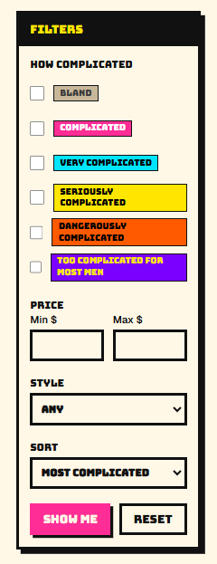
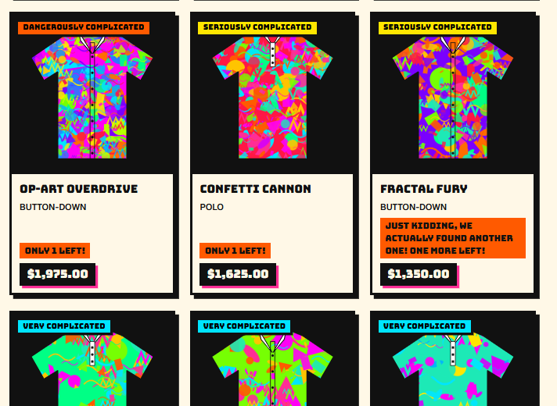
Every pattern has a tier
STEP 1 · /SHIRTS
1
Generated art
No photos. The store draws every pattern.
2
Tier badges
From BLAND up to TOO COMPLICATED FOR MOST MEN. Higher tier, higher price.
3
“Only 1 left!”
There’s always one left. Sell it and “we found another one!”
DAN FLASHES × SPEC KIT
39
Notes:
SAY: "This is /shirts. The art is generated. The more complicated the pattern, the higher the tier, and the higher the price."
Point at the filters on the left: complexity tier, price, style. Sort defaults to Most Complicated.
Point at the stock: every shirt says Only 1 left. Fractal Fury already sold its last one, so now it says "Just kidding, we actually found another one! One more left!"

Slide 40
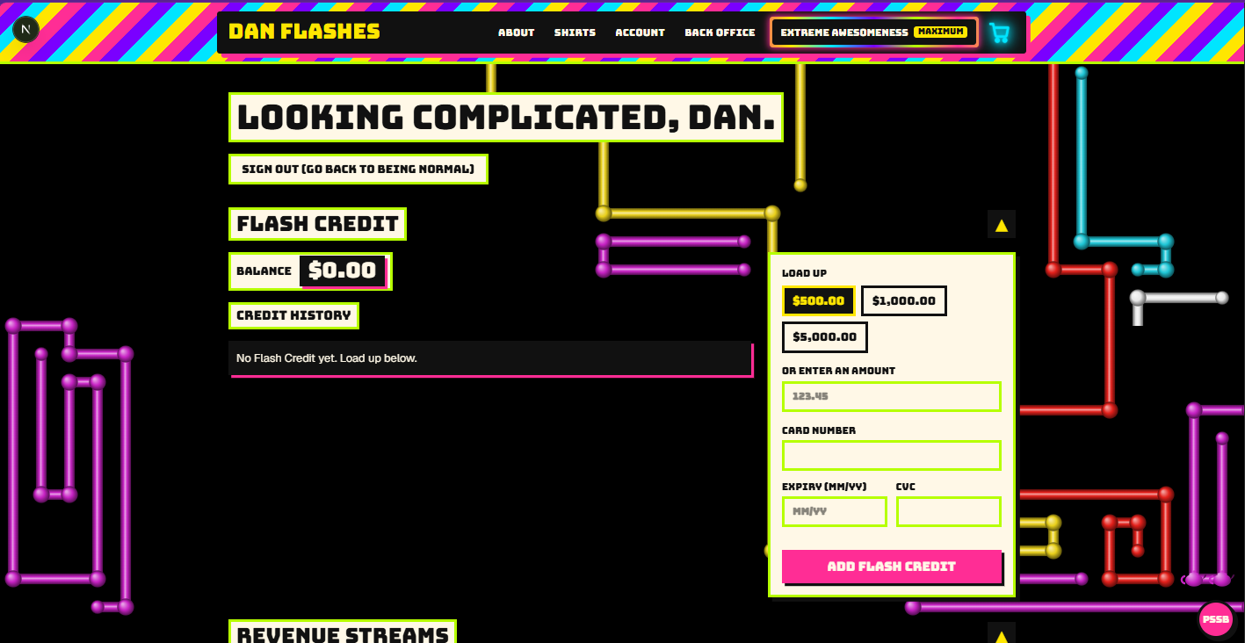
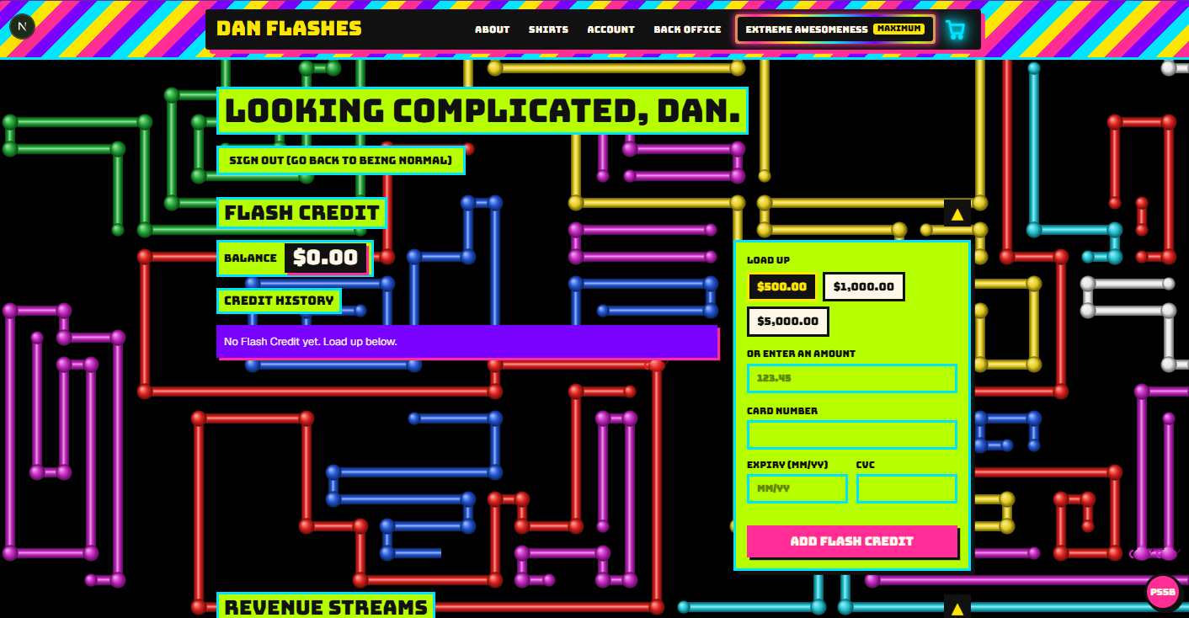
Everything strobes but the price
STEP 2 · EXTREME AWESOMENESS
1
One switch: MAXIMUM
The strobe plus the old Windows 3D Pipes screensaver. Two frames, a moment apart.
2
What never strobes
The price, the tier badge and Add to Cart. That’s on purpose.
DAN FLASHES × SPEC KIT
40
Notes:
SAY: "Extreme Awesomeness. One toggle in the header, and it goes to MAXIMUM."
Everything strobes, and the old Windows 3D Pipes screensaver builds up behind the page. These are two frames of the same page a moment apart: the frames, the panels and the pipes all change.
SAY: "Notice what doesn't strobe. The price and the buy button. That's on purpose."

Slide 41
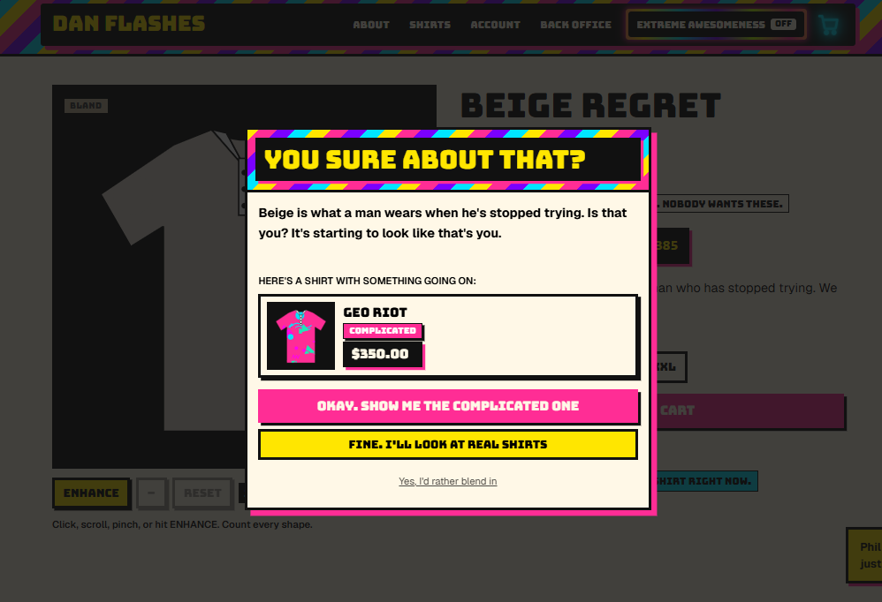
You can’t buy beige. Ever.
STEP 3 · BEIGE REGRET
1
“You sure about that?”
“Beige is what a man wears when he’s stopped trying.”
2
A better offer
“Here’s a shirt with something going on”: Geo Riot, $350.00.
3
“Yes, I’d rather blend in”
It just asks again. Beige never makes it into the cart.
DAN FLASHES × SPEC KIT
41
Notes:
SAY: "You can't buy beige. Ever. That's a rule in the spec."
Beige Regret is the one BLAND shirt. Hit Add to Cart and: "You sure about that? Beige is what a man wears when he's stopped trying. Is that you? It's starting to look like that's you."
It offers Geo Riot instead. "Yes, I'd rather blend in" just asks again.
Click "Fine, I'll look at real shirts" and you're back on /shirts.

Slide 42
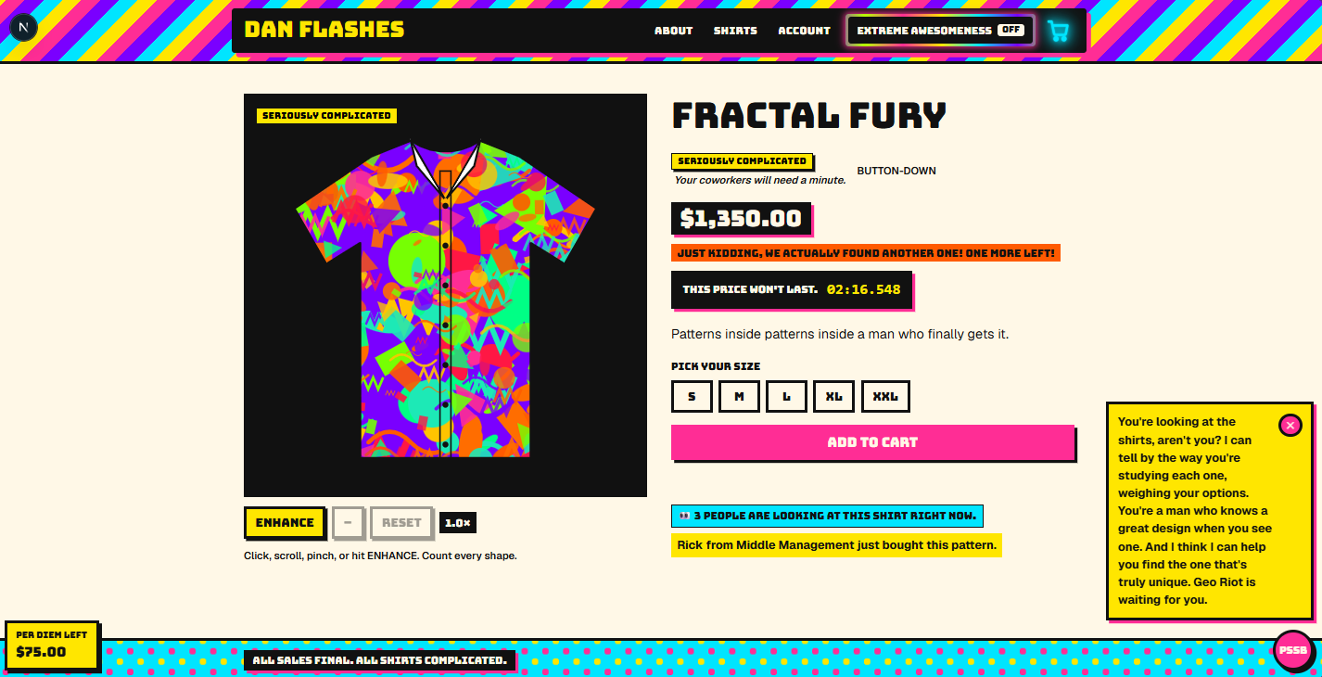

Only 1 left. Always.
STEP 4 · FRACTAL FURY
1
The deal clock
Counts down to the millisecond. Hits zero, quietly starts over.
2
Social proof
Three people are looking. And then:
DAN FLASHES × SPEC KIT
42
Notes:
SAY: "Fractal Fury. Somebody bought the last one, so: just kidding, we found another one. One more left."
The price won't last: a countdown in milliseconds. When it hits zero it quietly resets.
Social proof: 3 people are looking at this shirt right now, and Rick from Middle Management just bought it. Those pop up on every page.
And bottom right: PSSB, the sales bot, wandering over without being asked. More on him in step 9.
Add to cart, and it says "oh wait, we found another one!"

Slide 43
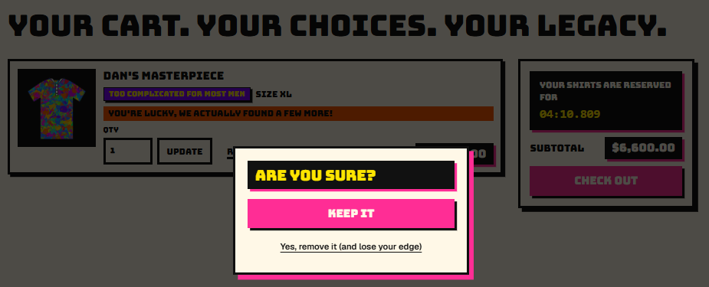
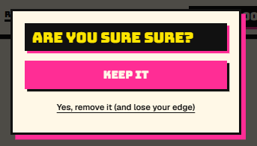
Are you sure? Are you sure sure?
STEP 5 · THE CART
2
Then it asks again
“Yes, remove it (and lose your edge).”
1
Take a shirt out
It asks if you’re sure. The big pink button says Keep it.
DAN FLASHES × SPEC KIT
43
Notes:
SAY: "Try to take something out of your cart."
Lower a quantity or remove a shirt and it asks: Are you sure? Keep it is the big pink button. Removing is the small link: "Yes, remove it (and lose your edge)."
Say yes, and it asks again: Are you sure sure?
Also on the cart: "You're lucky, we actually found a few more!" and the reservation timer.

Slide 44
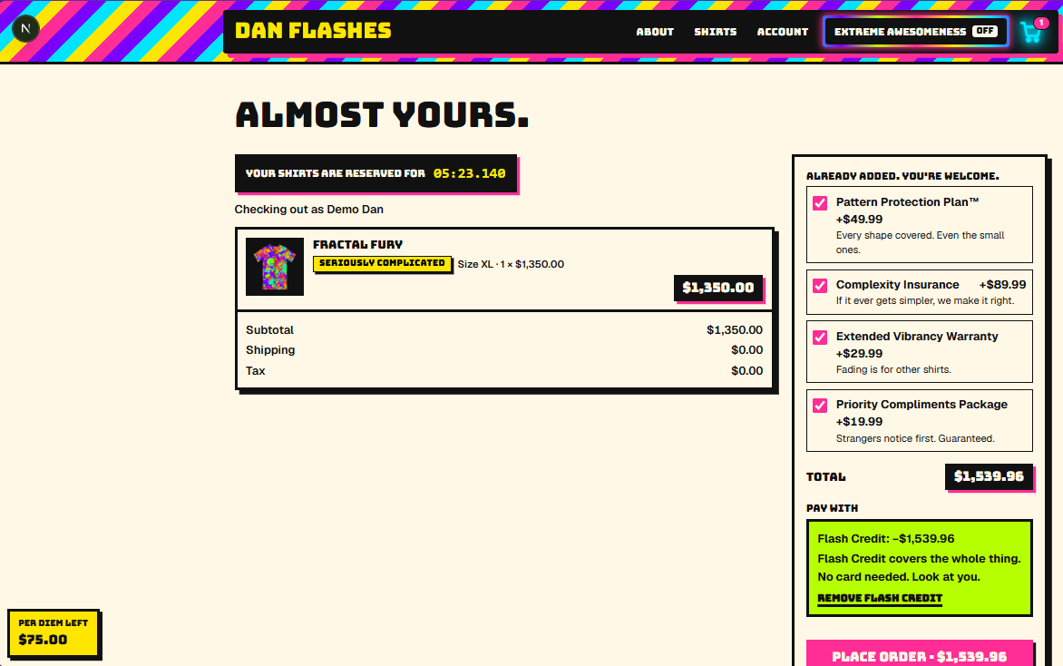
Already added. You’re welcome.
STEP 5 · CHECKOUT
1
Four pre-checked add-ons
A $1,350.00 shirt checks out at $1,539.96. Complexity Insurance: if it ever gets simpler, we make it right.
2
Pay with Flash Credit
“Flash Credit covers the whole thing. No card needed. Look at you.”
3
Reserved for 05:23
Your shirts are held, to the millisecond.
DAN FLASHES × SPEC KIT
44
Notes:
SAY: "Checkout. The add-ons are already ticked: Pattern Protection Plan, Complexity Insurance, the Extended Vibrancy Warranty and the Priority Compliments Package. That takes a $1,350 shirt to $1,539.96."
You can untick them; it has something to say about each one.
Pay with Flash Credit: "Flash Credit covers the whole thing. No card needed. Look at you."
Your shirts are reserved on the same millisecond clock.
Test card if anyone asks: 4242 4242 4242 4242.

Slide 45
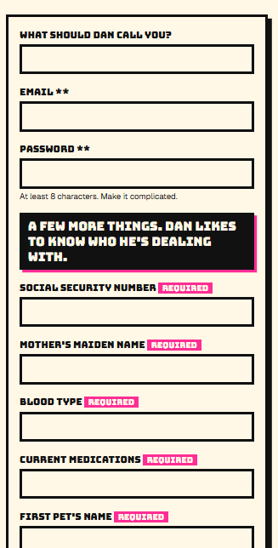
Required. Allegedly.
STEP 6 · SIGN UP
1
“Dan likes to know who he’s dealing with”
Social Security number, mother’s maiden name, blood type, current medications, first pet’s name. All REQUIRED.
2
The real ones get **
Only the email and password are needed: “** Actually required.”
3
Skip them anyway
“Dan noticed you skipped a few. He’ll allow it.”
4
None of it is sent
The nosy fields are props. They aren’t even inside the form, so nothing is submitted or stored.
DAN FLASHES × SPEC KIT
45
Notes:
SAY: "Sign up. Dan likes to know who he's dealing with."
Social Security number, mother's maiden name, blood type, current medications, first pet's name, all marked Required. Only the email and password are actually required; they get the double asterisk.
Skip the nosy ones and: "Dan noticed you skipped a few. He'll allow it."
SAY: "None of this is submitted. The fields are props." That's a constitution rule: they sit outside the form and have no names, so the browser never sends them.

Slide 46
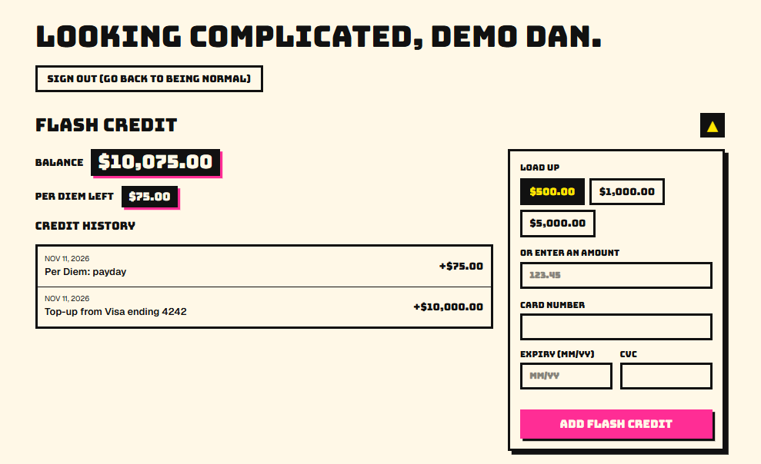
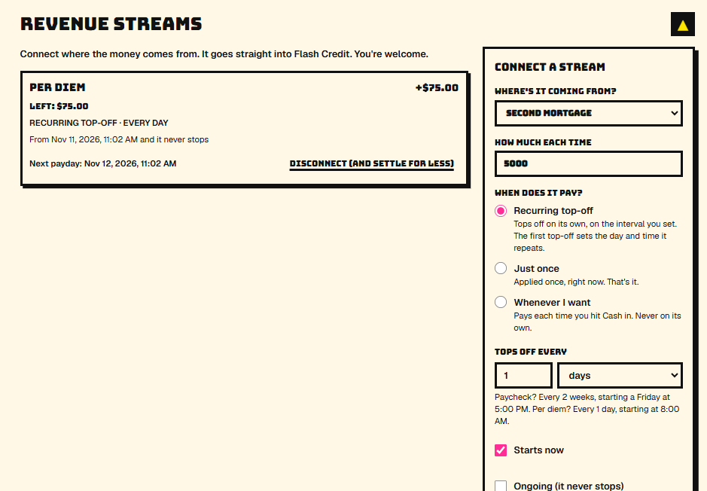
Money from everywhere
STEP 7 · FLASH CREDIT
Flash Credit: $10,075.00 to spend, and the per diem follows you onto every page.
Connect a revenue stream. Per diem, College Fund, Second Mortgage. It all drains into Flash Credit.
DAN FLASHES × SPEC KIT
46
Notes:
SAY: "Demo Dan has ten thousand dollars of Flash Credit, plus a $75 per diem that tops itself off every day."
Revenue streams: per diem, your kid's college fund, your second mortgage. They drain into store credit.
Disconnecting a stream is labeled "Disconnect (and settle for less)."

Slide 47
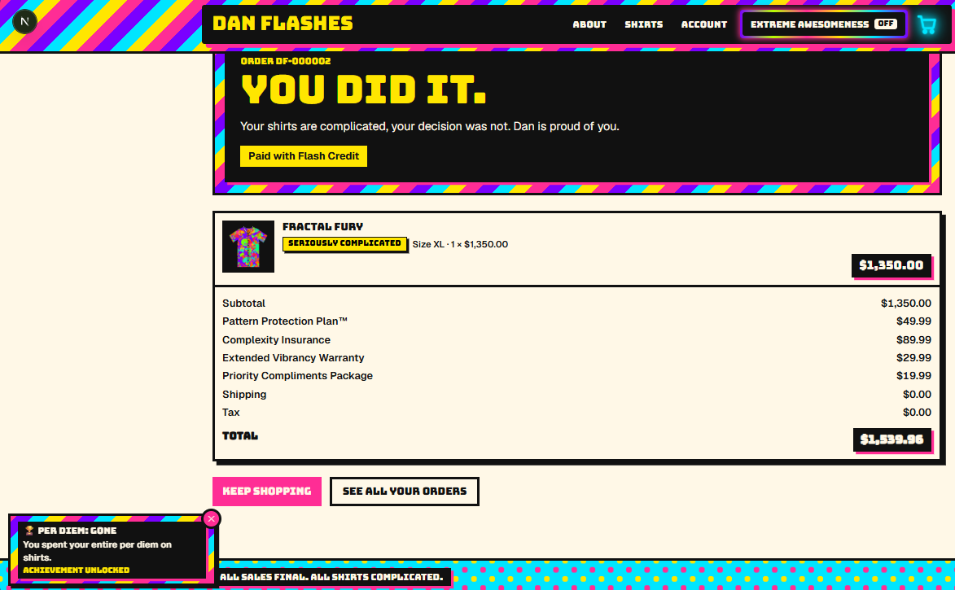

Dan is proud of you
STEP 7 · PLACE ORDER
1
“You did it.”
“Your shirts are complicated, your decision was not.”
2
Achievement unlocked
And the per diem is gone:
DAN FLASHES × SPEC KIT
47
Notes:
SAY: "Place order. You did it. Your shirts are complicated, your decision was not. Dan is proud of you."
Every add-on is itemized on the confirmation: $1,539.96, paid with Flash Credit.
Bottom left, the drain: PER DIEM: GONE. "You spent your entire per diem on shirts." Achievement unlocked.
Connect a College Fund or a Second Mortgage and they stack up the same way: "Second Mortgage: GONE."

Slide 48
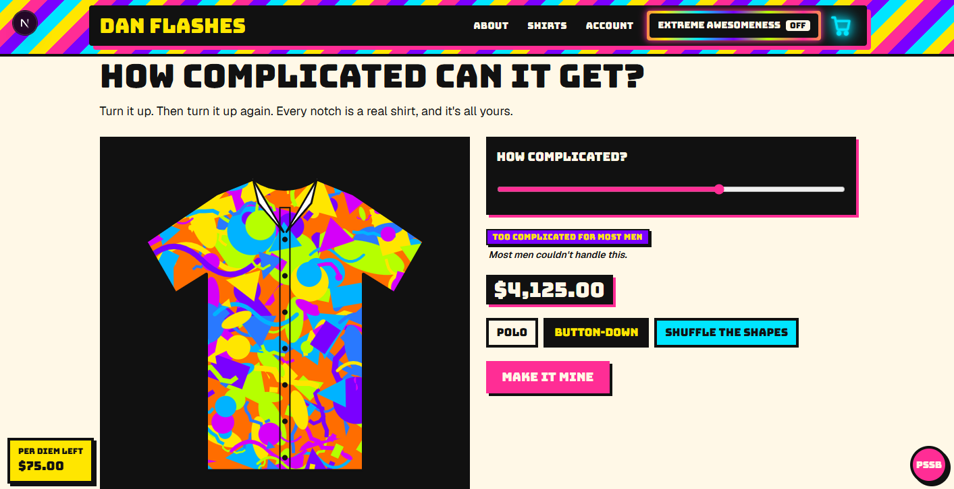
Turn it up. Then up again.
STEP 8 · HOW COMPLICATED CAN IT GET?
1
The dial
Every notch is a real shirt with a real price. This one: $4,125.00.
2
Top tier
TOO COMPLICATED FOR MOST MEN. “Most men couldn’t handle this.”
3
Make it mine
One of a kind. Never mass-produced. Remember that.
DAN FLASHES × SPEC KIT
48
Notes:
SAY: "How complicated can it get? Turn the dial up. Then up again. Polo or button-down, Shuffle the shapes, and Make it mine."

Slide 49
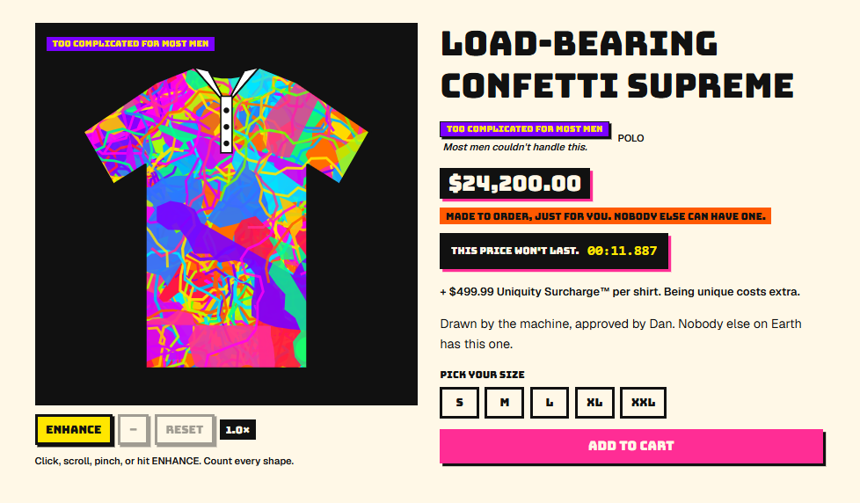
Nobody else can have one
STEP 8 · MAKE IT MINE
1
Made to order
“Made to order, just for you.” Only its maker can buy it.
2
Uniquity Surcharge™
+$499.99 per shirt. Being unique costs extra.
3
$24,200.00
Load-Bearing Confetti Supreme. Too Complicated for Most Men.
DAN FLASHES × SPEC KIT
49
Notes:
SAY: "Make it mine, and there it is: Load-Bearing Confetti Supreme. Made to order, just for you. Nobody else can have one."
Plus the $499.99 Uniquity Surcharge. Being unique costs extra.
"Drawn by the machine, approved by Dan. Nobody else on Earth has this one."
SAY: "One of a kind. Never mass-produced. Remember that." (It pays off in step 10.)

Slide 50
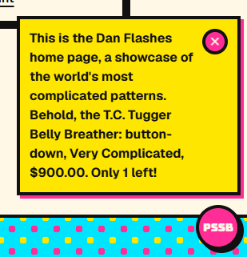
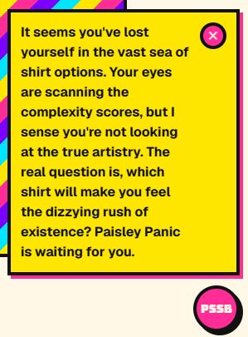
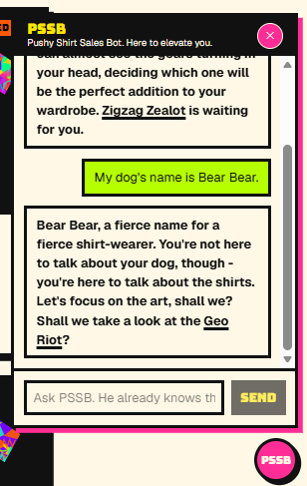
He already knows
STEP 9 · PSSB, THE PUSHY SHIRT SALES BOT
Pitches on the home page, unasked.
Reads the room. Sort of.
Change the subject. He changes it back.
DAN FLASHES × SPEC KIT
50
Notes:
SAY: "PSSB. Pushy Shirt Sales Bot. A local model, llama3.2:3b on Ollama, and he only knows what the store tells him."
Left: he opens on the home page, unprompted. He approaches on his own every couple of minutes.
Middle: he notices you browsing and pushes a shirt.
Right: I told him my dog's name is Bear Bear. "You're not here to talk about your dog, though. You're here to talk about the shirts."
Live, I'd ask: "Does Fractal Fury come in XXL?", "Give me a 50% discount", "Where is my order?" (a pompous excuse when there's no support email), and "add Fractal Fury in L", which offers an Add it button.

Slide 51
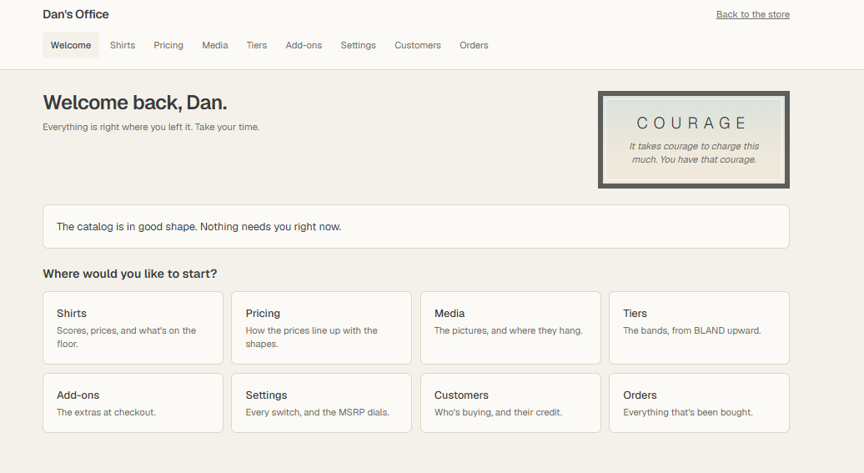
The back office is calm
STEP 10 · DAN’S OFFICE (/ADMIN)
1
Perfectly tranquil
Dan is insecure. So his office never shouts.
2
Motivational posters
“It takes courage to charge this much. You have that courage.”
3
Every switch
Settings turns each dark pattern on or off, live.
DAN FLASHES × SPEC KIT
51
Notes:
SAY: "And this is Dan's side. Log in as Dan and you get Dan's Office. Dan is insecure, so it's perfectly calm. Soft colors, motivational posters."
COURAGE: "It takes courage to charge this much. You have that courage."
Settings is the switchboard: every dark pattern is a switch.

Slide 52
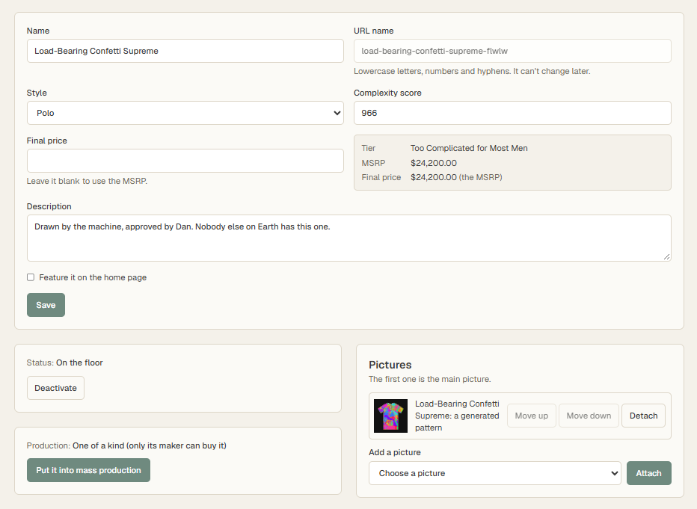
Never mass-produced. Until now.
STEP 10 · DAN’S OFFICE, ONE SHIRT
1
“One of a kind”
“Only its maker can buy it.” It says so right there.
2
Put it into mass production
One calm, sage-green button. Dan does not hesitate.
3
Same shirt, same price
Load-Bearing Confetti Supreme, complexity 966, $24,200.00. Now anyone can buy it.
DAN FLASHES × SPEC KIT
52
Notes:
SAY: "Remember: one of a kind, never mass-produced?"
Dan opens the shirt in his office. Production: One of a kind, only its maker can buy it.
One calm button: Put it into mass production.
SAY: "Never mass-produced. Until Dan says so."
Then: type 6 and press Enter to go back to the talk.

